Slide 1

Azure Infrastructure Overview
Notes:
Hello, and welcome to our overview of Azure Infrastructure-as-a-Service offerings.
I am, [name, title, company]
[speaker introduces expertise in this area]
Let’s jump in …

Slide 2

Agenda
State of the Cloud
Overview
Azure Infrastructure Advantage
Azure IaaS technologies
Notes:
Today, we want to talk about the infrastructure that enables cloud computing …
What’s happening in the market
So, we’ll begin by defining Infrastructure as a Service
Then we’ll talk about why Azure is an industry-leading IaaS provider
Before we deep-dive into the technologies that Azure offers to build your infrastructure

Slide 3
Journey to the Cloud
Migrate
Application Modernization
SaaS
Rehost
Refactor
Rearchitect
Rebuild
Replace
On-Premises
Infrastructure Platform
IaaS
Infrastructure Platform
“lift & shift”
Containers
Managed Container Platform
PaaS/Serverless
Application Platform
SaaS
Notes:
Source: Gartner: “Developing a Public Cloud IaaS Adoption and Migration Framework” published March 2017
Rehosting: Rehosting is also referred to as a "lift-and-shift" migration. In essence, the application is moved into the IaaS environment of a cloud provider while avoiding as many modifications to the system as possible. In this case, you would not be taking advantage of cloud technology such as autoscaling, for example.
When to consider:
Ideal when your goal is to improve operational efficiencies, and free up data center space
Maintenance apps for which the hardware is not worth additional investment
Compute-intensive applications that are built for parallelism but don't require high-performance interprocess communications (IPC) and have independent datasets, and applications for which load balancing already increases scalability and availability.
Benefits
Drives higher ROI (435% from migration to IaaS). Try our TCO Calculator.
No need to manage data centers
Enjoy flexible and scalable infrastructure
Core technologies: VM, VM Scale sets
Refactor: Refactoring an application involves some change to the application design, but not wholesale changes to the application code. The application takes advantage of IaaS and potentially PaaS capabilities from the provider while maintaining code strategic to the application's use case.
Customers typically have a large portfolio on custom developed on-premise applications (.Net and OSS e.g. Java).
They are concerned about cost efficiency, security, and ongoing management/evolution of these apps. They are interested in the cloud to address these concerns, but are worried about how they can get there in an efficient way that optimizes/modernizes the application and make it more portable as they journey to the cloud.
They are increasingly looking to containers as the vehicle to modernize and move their applications to the cloud without significantly re-architecting their solutions.
Benefits
Drive continuous innovation by leveraging built-in DevOps or using Containers.
Easily scale up or down to meet the changing needs of the business
Improved portability and density.
Existing programming models, languages and frameworks that can be easily used and extended.
Technologies used: Containers , Container Orchestrators (Docker Swarm, DC/OS- Mezoshphere, Kubernetes)
Rearchitect: Rearchitecting an application for cloud usage enables you to take advantage of technologies such as autoscaling and dynamic reconfiguration. This process will require developer resources to implement and can take significant time to implement
When to consider
When apps need a major revision to incorporate new capabilities or take advantage of the cloud-native capabilities.
Benefits
Deliver new capabilities and modernization through modified codebase and a monolithic to micro services architectural revision.
Reduce the volume of code needed to express a capability while still leveraging existing investments.
Agility and scale.
Core Technologies
PaaS (e.g. Azure App Service), Serverless (Azure Functions and Logic Apps), Microservices (Service Fabric )
Legacy Apps
Monolithic - Built as a single unit with few separate services or components. Any services which are used tend to be custom built for the App.
Tightly Coupled - Tend to have internal and external dependences that impact both reliability and development agility.
Long Delivery Cycle - Slow to test, deploy, and scale. Making iteration difficult.
IT Dependent - Dependent on long lead time bare metal provided by IT. With complicated patching and update process.
Internet Apps
Service Oriented - Build modularly using packaged middleware, common services, and SOA architectures.
Loosely Coupled - Technology like messaging stacks and queues used to disintermediate apps. Management and diagnostic tools integrated into Apps.
Agile Delivery - Dependency management and disintermediation allows software to be built incrementally. Shortening delivery times from years to months.
Virtualized - Software hosted on virtualized infrastructure that reduces IT dependencies, improves delivery time, and simplifies update process.
Cloud Apps
Cloud Based Service - Applications built using API’s, SaaS Services, and independently scaling Microservices. With custom code only needed for core business logic.
Distributed - Applications use cloud services and API’s, further disintermediating tiers. Often taking advantage of on demand services that are not instantiated when not in use.
DevOps - Continuous Integration, Continuous deployment, and Testing in Production used to shorten delivery and scale times from months to days or hours.
Platform Based - Applications written to PaaS or IaaS based cloud platforms. Reducing scale times to minutes or even seconds and simplifying the patching and deployment process.

Slide 4
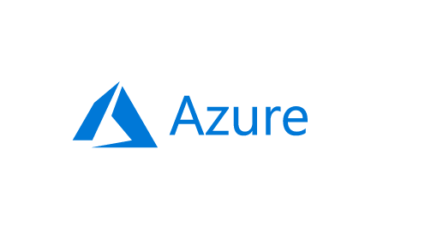
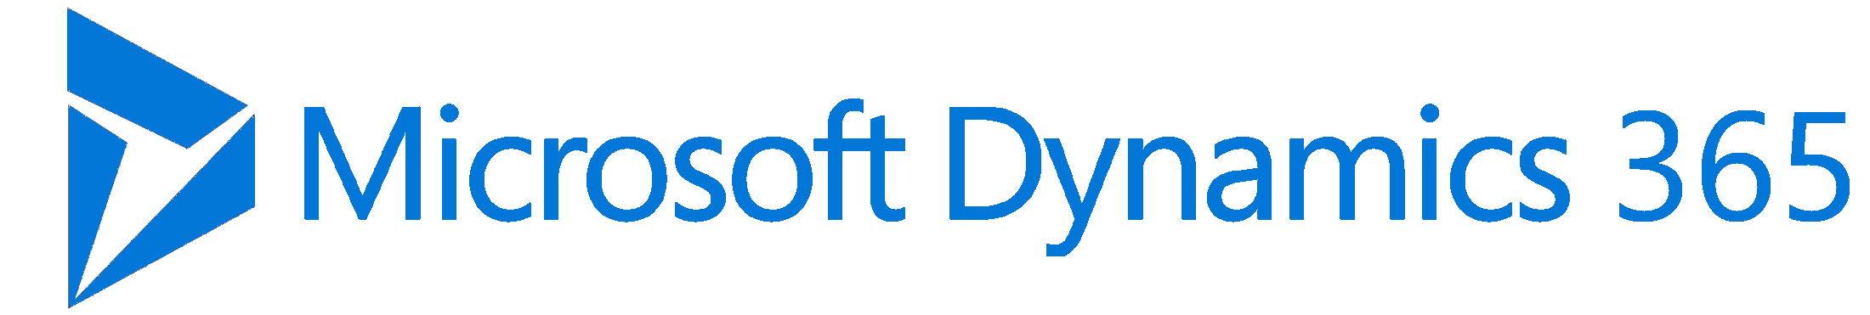
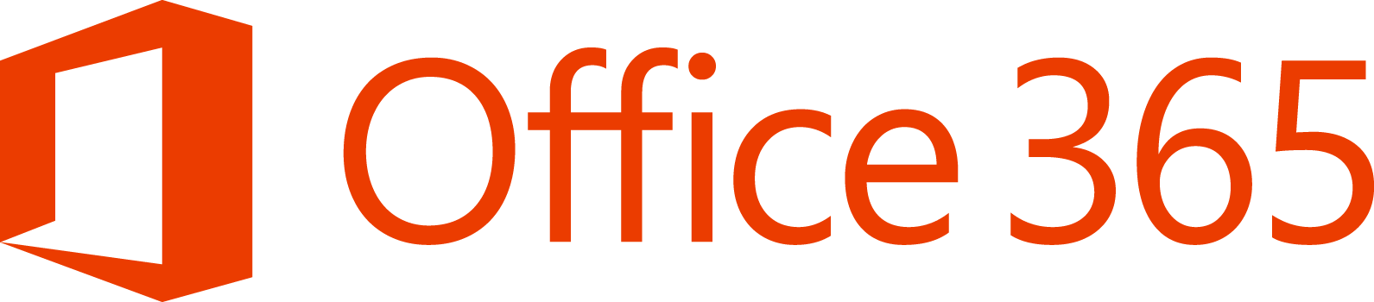
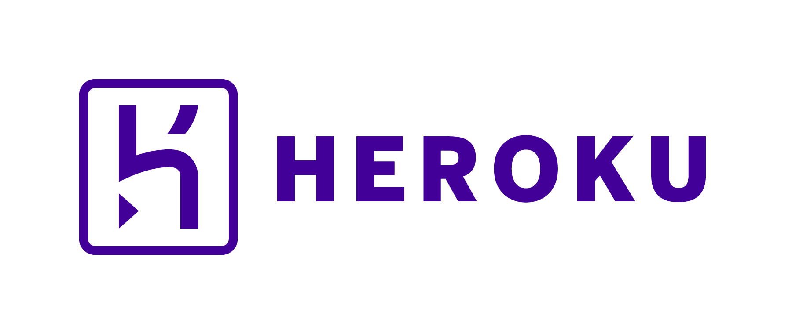
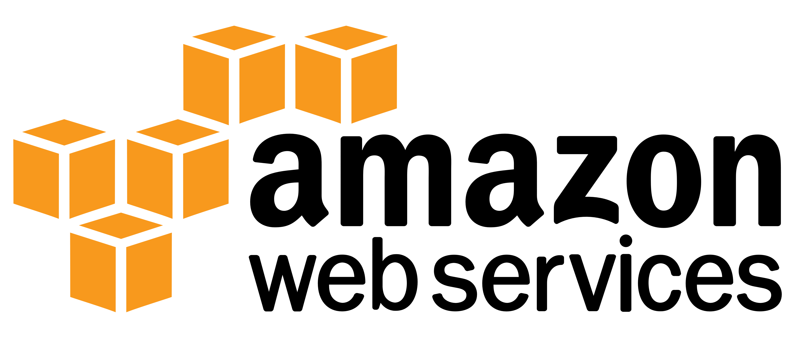
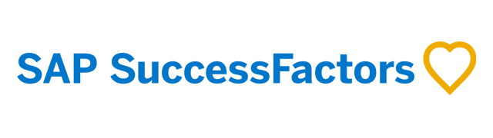
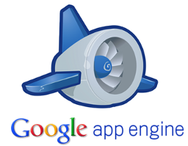

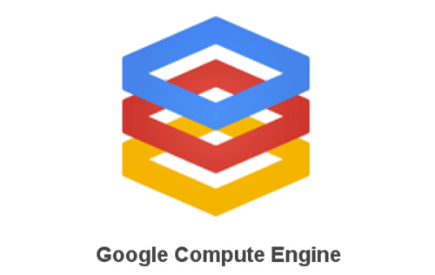
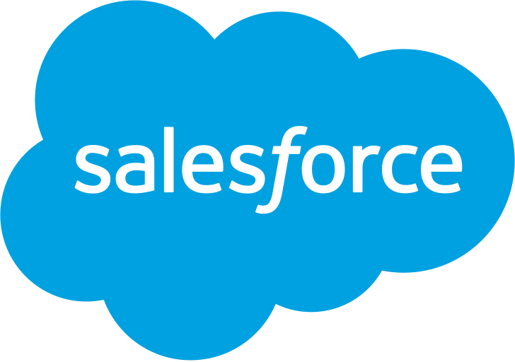
IaaS Overview
Traditional
on-premises
Infrastructure
(as a Service)
Platform
(as a Service)
Software
(as a Service)
Applications
Applications
Applications
Applications
You manage
Data
Data
Data
Data
Runtime
You manage
Runtime
Runtime
Runtime
Middleware
Middleware
Middleware
Middleware
You manage
O/S
O/S
O/S
Managed by vendor
O/S
Virtualization
Virtualization
Managed by vendor
Virtualization
Virtualization
Servers
Servers
Servers
Servers
Managed by vendor
Storage
Storage
Storage
Storage
Networking
Networking
Networking
Networking
You manage
Managed by vendor
Notes:
As you can see, the cloud journey includes many service scenarios:
On the left, you have a traditional, on-premises infrastructure which you manage completely on your own.
On the right, you have Software-as-a-Service, which includes all of the web-based tools and applications you use to run your business—think of Office 365 or Dynamics 365—running completely in the cloud, and managed fully by the vendor that provides the software.
In the middle, we have infrastructure and platform services. Building out your cloud infrastructure is your first step in moving to the cloud.
Infrastructure as a service (IaaS) is an instant computing infrastructure, provisioned and managed over the Internet. It enables you to quickly scale up and down with demand, and pay only for what you use.
IaaS helps you avoid the expense and complexity of buying and managing your own physical servers and other datacenter infrastructure.
Each resource is offered as a separate service component, and you only need to rent a particular one for as long as you need it.
The cloud computing service provider manages the infrastructure, while you purchase, install, configure, and manage your own software—operating systems, middleware, and applications.

Slide 5


67% of customers are either using or planning to use Hybrid technologies in the near future The biggest motivators are cost optimization (34%) and consistency across infrastructure (33%) Security was the top barrier to overcome followed by compatibility and compliance
Based on the State of the Cloud CMR Report, March 2018
Notes:
The greatest challenges organizations face in implementing cloud platforms and technologies include a lack of resources and expertise, security, and managing cloud spend (all 25%), as well as compliance and governance and control (both 23%)
– RightScale
*Based on RightScale report with 1,002 technical professional respondents

Slide 6
Top challenges of moving workloads to the Cloud
Heterogeneous workloads
Hybrid
Security & management
Monitoring & managing costs
Notes:
The greatest challenges:
Lack of resources and expertise
Security
Managing cloud spend
Compliance, governance, and control
As you saw earlier, many customers are moving to Infrastructure as a Service. While the cloud offers many benefits, customers are also facing a few challenges presented by a fast-evolving cloud environment. For example …
Complex, heterogeneous workloads—with so many infrastructure services on the market today, it is difficult to know where to start …
Maybe you want to maintain control of your data on-premises while taking advantage of the innovative fabric of cloud infrastructure?
Many customers have different applications, platforms, and workloads that need to run on the same infrastructure.
Perhaps you want to leverage some of the existing investments in your on-prem infrastructure while also optimizing the scalability and agility of the cloud?
Acquisitions and partnerships can also complicate IaaS adoption, creating a need to improve scale and performance.
Application workloads may be creating a demand for increased capacity and performance requirements.
Cost and time of implementation
Cloud spend is on the rise. In fact, according to IDC, cloud services spending will grow 7x faster than overall IT spending.
With a massive shift to the cloud, customers are trying to get a comprehensive picture of how resources are being allocated and whether assets are being optimized.
And, once the usage is identified, customers want to be able to govern how cloud assets are allocated across the organization.
Even if economics and use-benefits work out, migration can be complex and time consuming.
Security and management concerns
Cyber threats are becoming increasingly sophisticated—attacking data in transit, and data at rest in datacenters worldwide.
Many companies fear that with data spread across the globe (in the cloud), it is difficult to protect business-critical information.
Managing security for on-prem and cloud environments is the top priority for IT professionals.

Slide 7
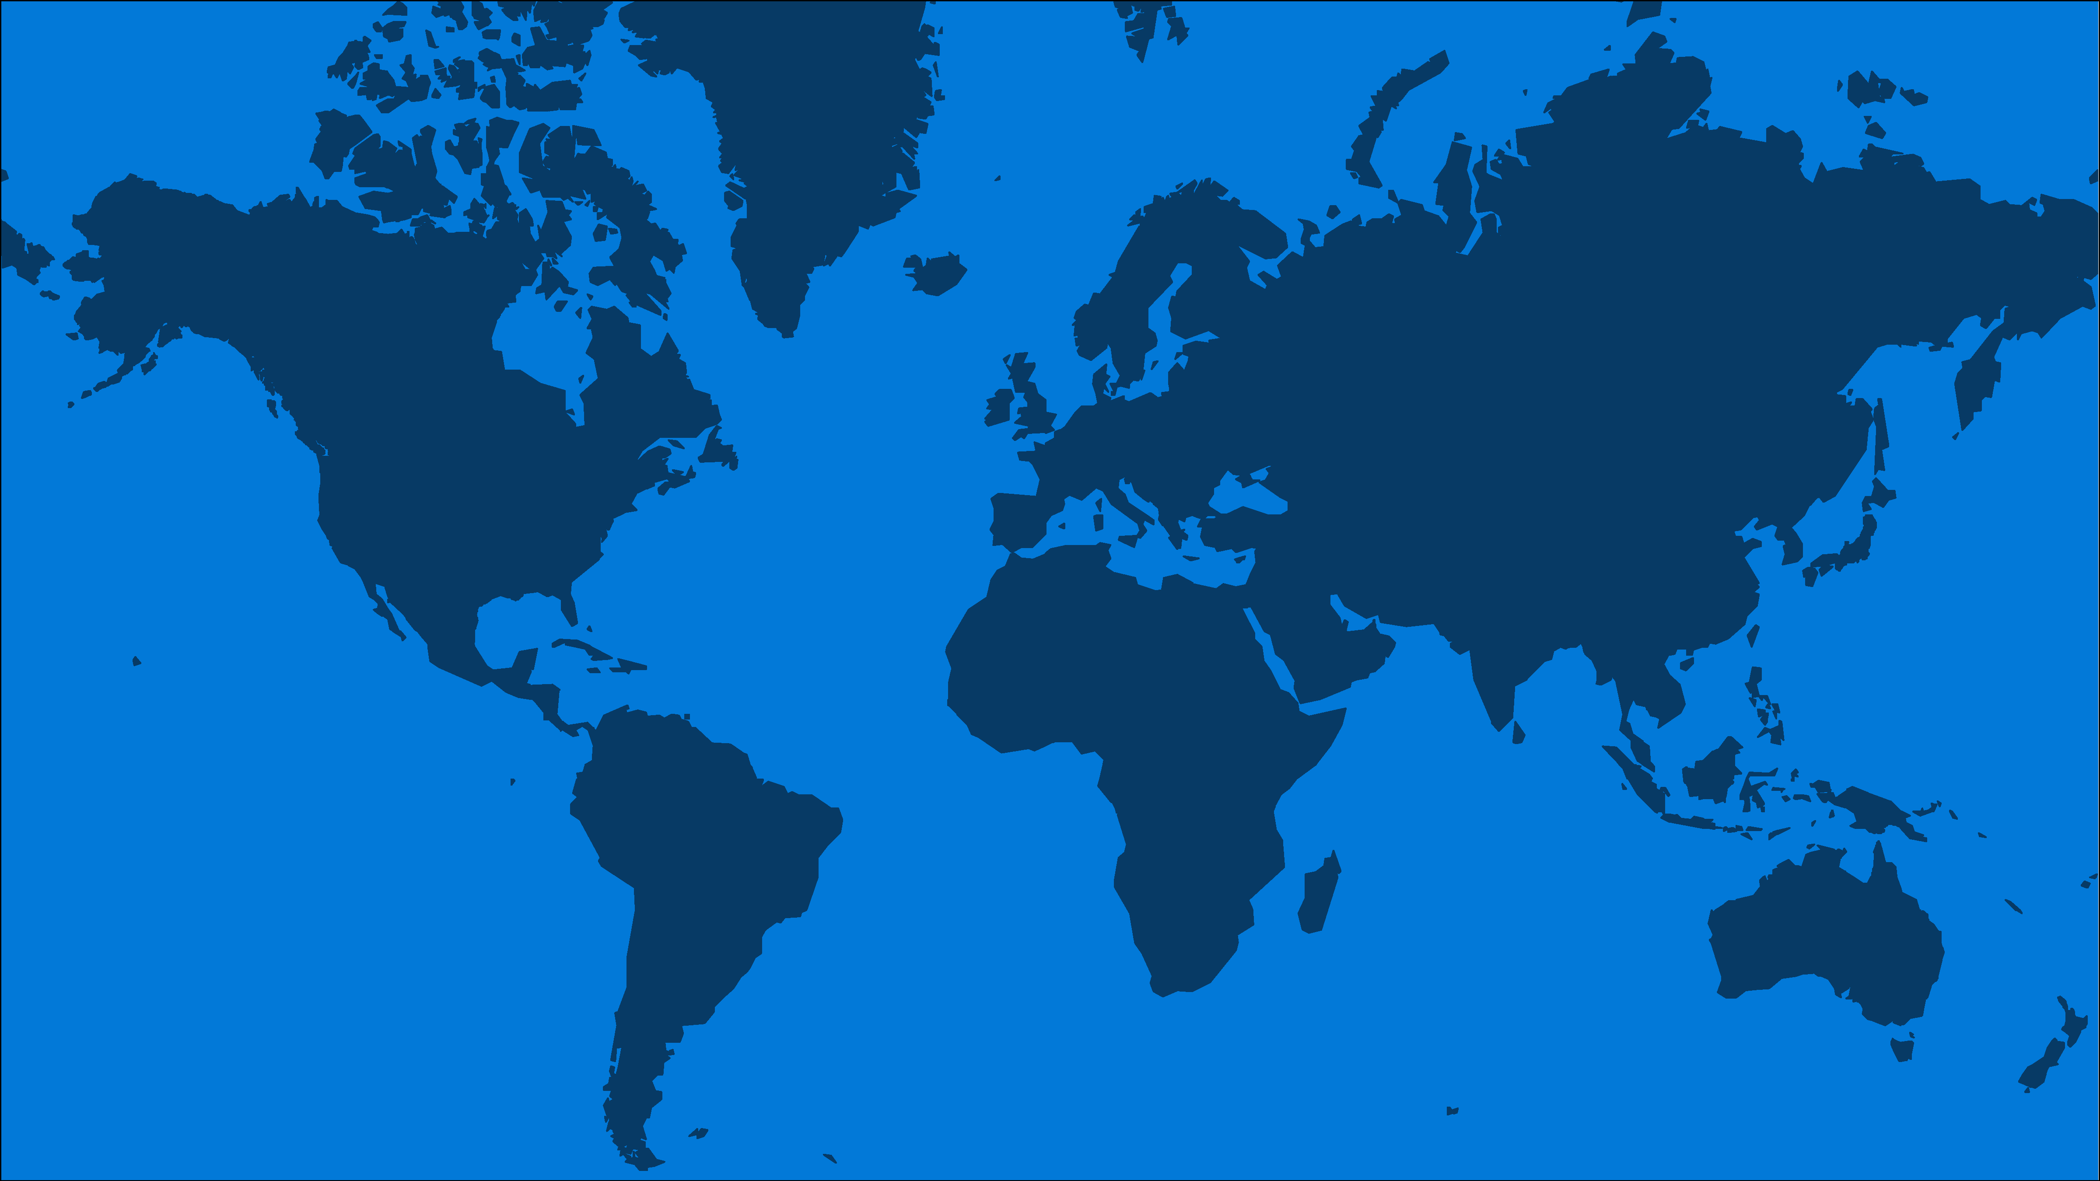
Azure IaaS Advantages
Global Presence
Infrastructure for all workloads
Hybrid
Secure & well-managed
Cost effective
50+
4,500+
130+
AZURE REGIONS
PEERING LOCATIONS
EDGE SITES
Notes:
Azure IaaS solutions offer:
A modern infrastructure for all your workloads
Secure and well-managed
A cost-effective environment
Let’s drill-down into each of these benefits …
Azure is actively expanding its infrastructure around the globe, including being the first cloud provider with data centers in South Africa.
In fact, we have made a $10B investment in our data centers in order to develop the infrastructure for all workloads.
Right now, we’re at 42 Azure regions—more than AWS and Google combined.
Unlike other providers, we feel it makes a crucial difference in customer experience to have data close to employees and customers as well as offering individuated data handling capabilities.
The public cloud is about commoditized hardware …

Slide 8
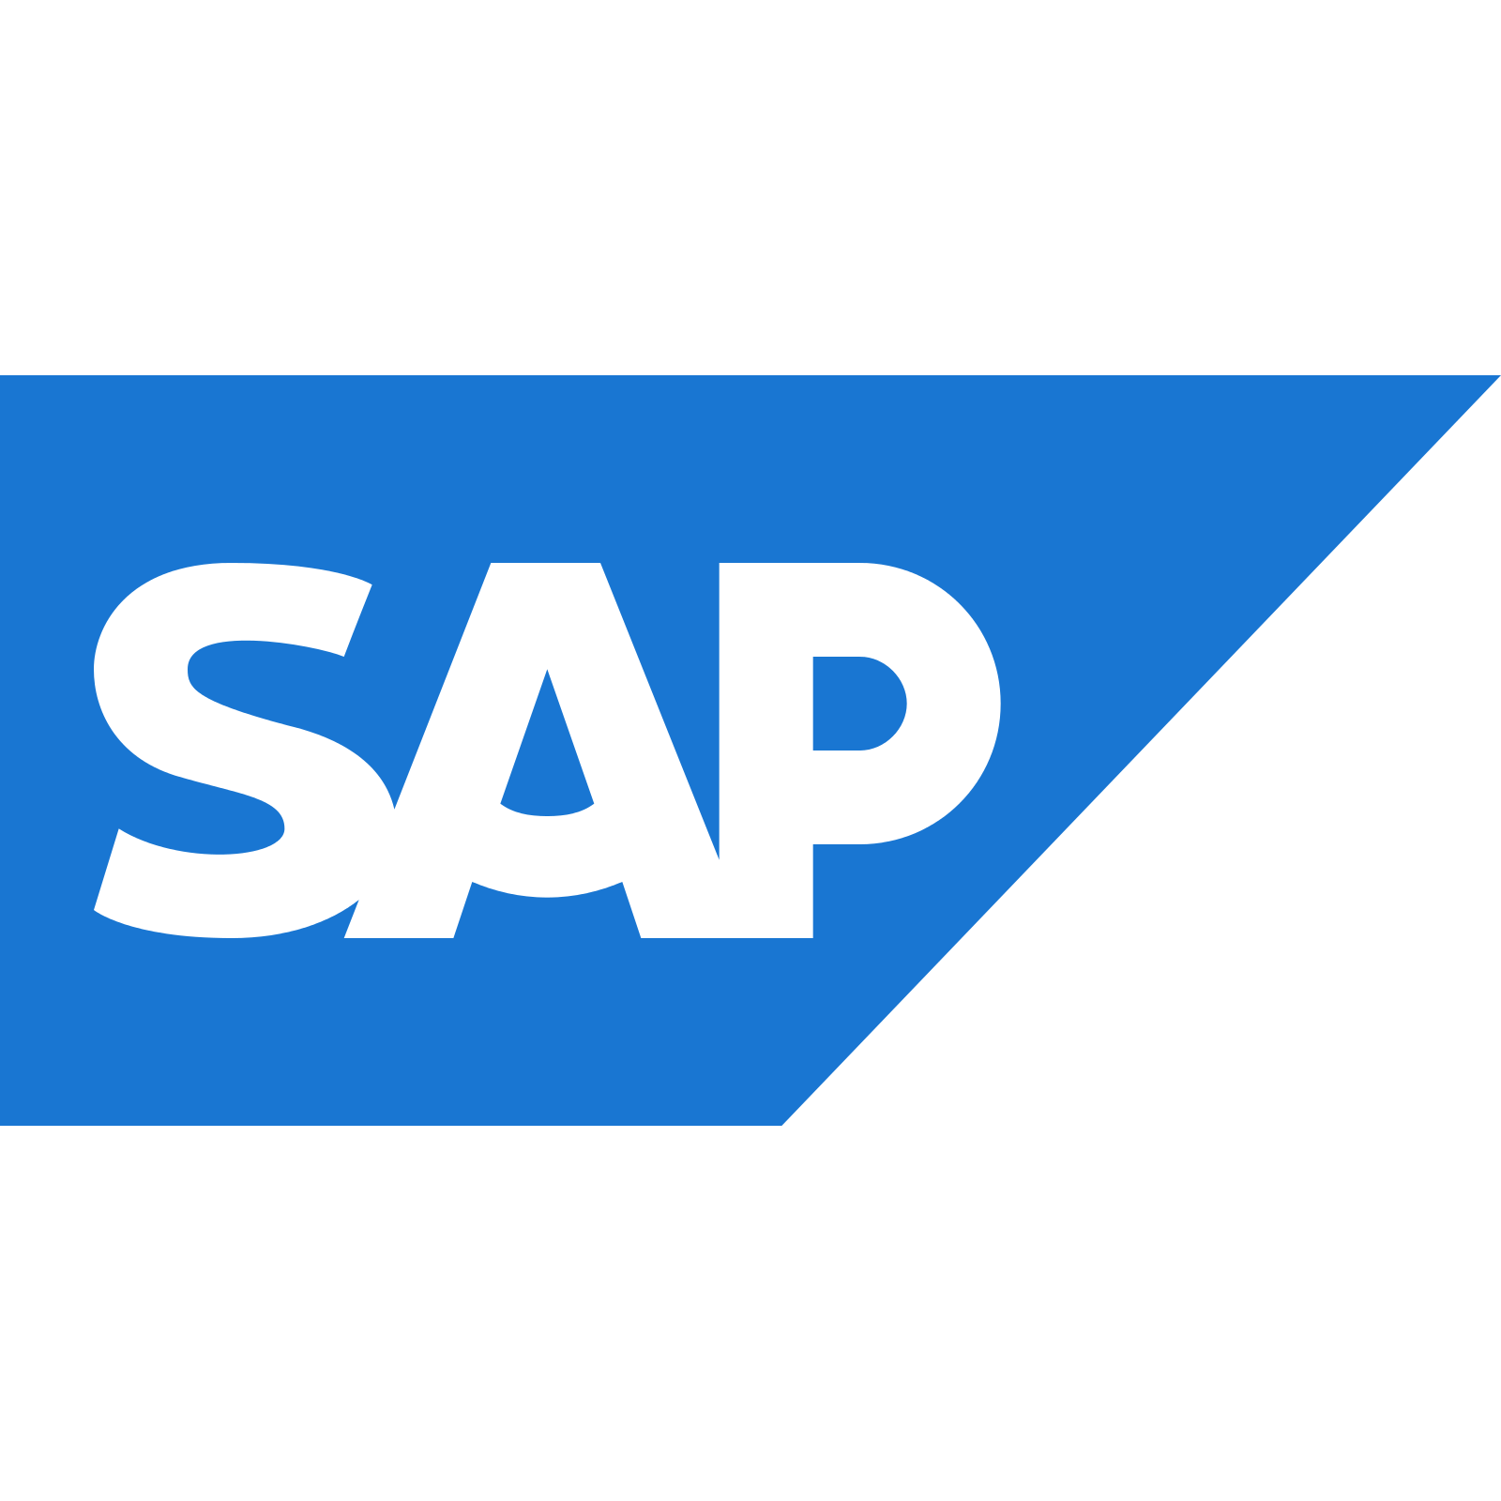


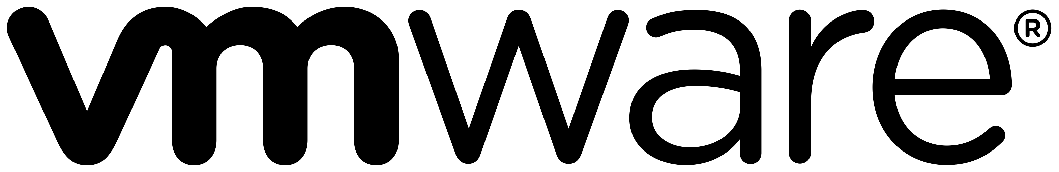
On-demand infrastructure
Purpose-built infrastructure for specialized workloads
Infrastructure for all workloads
Hybrid
Compute
Secure & well managed
Networking
Cost effective
Storage
Notes:
What do we mean when we say “modern infrastructure”?
Azure IaaS offers a purpose-built IT infrastructure designed to fit your company’s needs, rather than the other way around
This is accomplished through utilizing the experience we’ve gained in a 300,000-plus partner global ecosystem, which is 5 times greater than Google’s partner network.
Microsoft also has deep experience with many different kinds of industries
Our global data centers offer you support for all your applications when and where you need it
We are differentiated from our competitors by offering a first-class experience that has been recognized by such partner certifications as SAP and Red Hat
And we can tailor our support for any specialized needs you may have—regardless of whether you are managing on-premises, hybrid, or cloud-only infrastructures
Purpose-built infrastructure
A combination of virtual machines and purpose-built large instances provides the largest scale and widest range for your workloads.
With an on-demand infrastructure, you and leverage per-minute billing and scale your CPU and RAM usage up or down based on your application workloads.
However, for large instances, on-demand infrastructure can be cost prohibitive. That’s why Azure offers purpose-built infrastructures, which allow you to customize your infrastructure based on your specific workload needs.

Slide 9



Linux, Open Source, and Red Hat
Infrastructure for all workloads
Hybrid
40% of Azure VMs are running Linux
1.4x growth of Linux
Co-located support with Red Hat on-site team
Secure & well managed
Cost effective
*Source: https://azure.microsoft.com/en-us/blog/draft-blog-post-on-red-hat-customers-pre-red-hat-summit/
Notes:
For Cloud Access (BYOS) as well as On-Demand (PAYG) deployments
Linux and Open Source
… which is why we provide the hardware for Windows and Linux platforms …
Given Microsoft makes Windows Server, there is no better place to run Windows platforms than on Windows Server. They were, quite literally, made for each other.
But, we don’t stop at Windows …
33% of our partners are running Linux.
Which is why Microsoft has established relationships with big Linux providers.
In fact, Microsoft is doing something the industry has never seen before … we’ve developed an integrated support model with Red Hat support sitting with our support teams in Redmond.
“Red Hat really impressed us with its enterprise grade support. We were surprised that Red Hat open source and Azure support resided in the same office. ” —Richard Hum: Studio Head —Throwback Entertainment

Slide 10



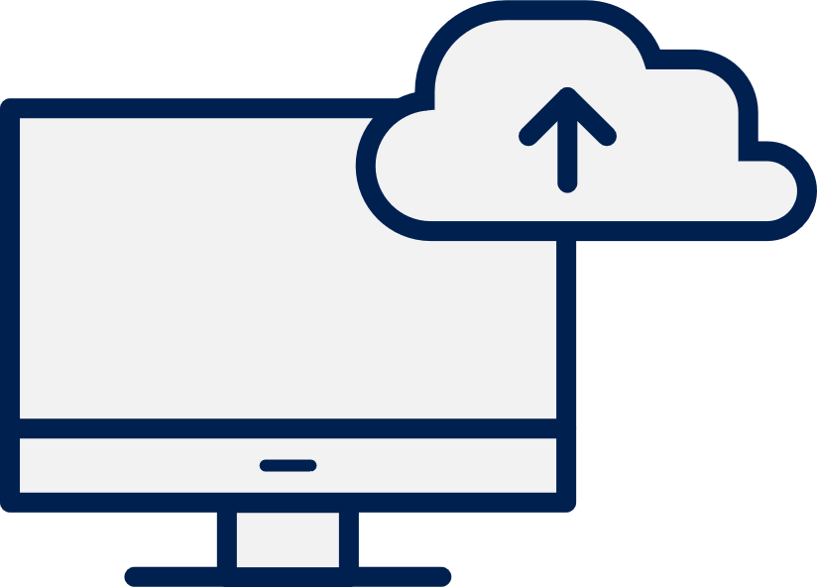
Azure is the best infrastructure for your Windows Server and SQL workloads
Infrastructure for all workloads
Gain unparalleled cost savings
Save up to 67% compared to AWS RIs*
Infrastructure for all workloads
Hybrid
Easily plan migrations
Reduce datacenter footprint
Secure & well managed
First-class, first-party support
One source for service and support
Cost effective
Modernize apps beyond infrastructure
Gain up to 80% efficiency with Azure PaaS**
Sources: * General Availability of Azure Reserved VM Instances (RIs) announcement | **The Total Economic Impact Of Microsoft Azure IaaS, June 2017
Notes:
Azure Infrastructure as a Service provides customers with a secure and familiar platform, so IT can move their Microsoft on-premises applications in cost effective way. Microsoft applications and Azure have been built to work better together with flexibility, high compatibility and hybrid capabilities.
Customers can use the same familiar technologies they have been using for years without learning about new platforms, processes and procedures to speed productivity, reduce onboarding time with systems their staff is already familiar with, and lower staffing costs without the need for highly specialized or trained users.
The previously listed challenges are directly addressed in the following manner:
Get unparalleled cost savings – by keeping your Microsoft workloads on a Microsoft platform, you can take advantage of increased savings through licensing perks, the Azure Hybrid Benefit, and increased operational efficiencies. Save up to 67% compared to AWS RIs.
Easily plan migrations – remove the ambiguity of moving to the cloud with tactical steps designed to guide you on your way. We've helped numerous organizations map out and execute their migration strategies. Also leverage a variety of tools available to you, including Azure Migrate. Reduce datacenter footprint.
First, class first party support – no need to switch back and forth between workload and platform providers. When you stick with Microsoft, there's only source for your support needs. One source for service and support.
Modernize your apps beyond infrastructure - With Azure IaaS customers can build upon their existing investments in a highly flexible manner that allows you to move between the cloud and back depending on your specific organizational needs. Gain up to 80% efficiency with Azure PaaS.
Proof point sources:
* The Total Economic Impact Of Microsoft Azure IaaS, June 2017
** The Total Economic Impact of Microsoft Azure Platform-as-a-Service, June 2016

Slide 11
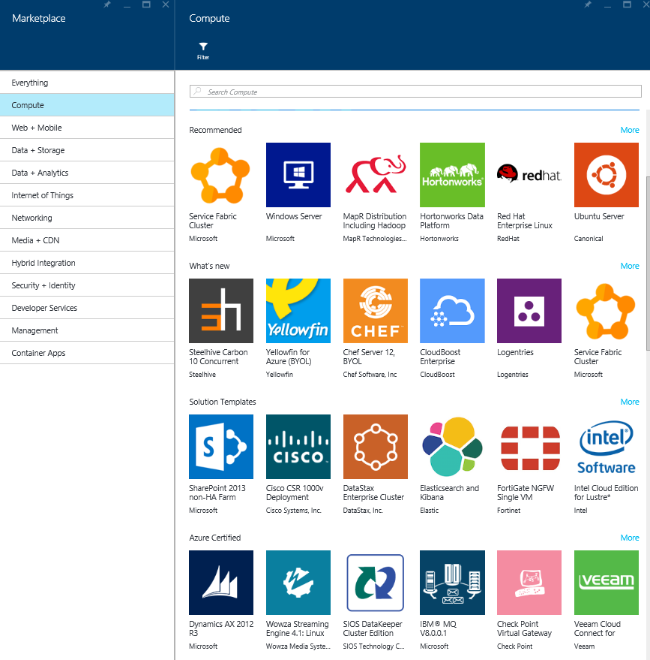
Infrastructure for all workloads
>4,000
Hybrid
Certified, pre-configured for Microsoft Azure Solutions in Azure Marketplace
Secure & well managed
Cost effective
Notes:
ISVs get your apps certified and putting them in front of over 500k Azure customers
Flexible pricing model: PAYG and BYOL

Slide 12
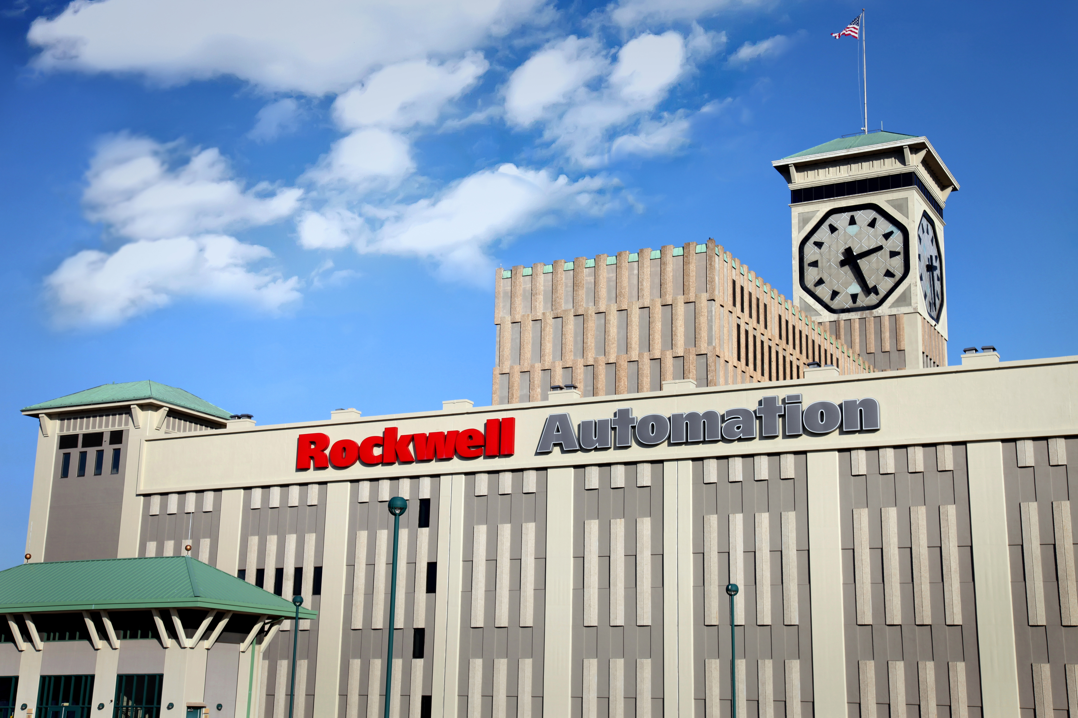
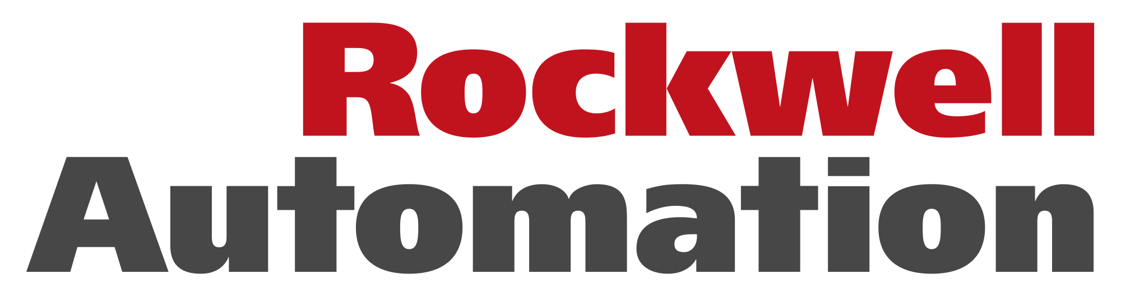
“Azure provides us the scalability, security and level of services needed to confidently run our most demanding SAP HANA and Big Data applications.”
—Sujeet Chand, Senior VP and CTO
Notes:
You saw how Rio Tinto benefited by migrating their SAP landscape to Azure, Now let’s talk about a customer that’s running SAP HANA on Azure.
RockWell Automation is a leading industrial automation company with 22,500 employees and customers in more than 80 countries.
Rockwell Automation wanted to strengthen its competitive advantage and open new business opportunities in the oil and gas industry by automating the collection and analysis of data from remote installations across the petroleum supply chain.
Rockwell chose Azure for their HANA deployments and decided to go with the purpose built SAP HANA infrastructure for scale and performance.
In addition to HANA, RockWell is using Azure IoT and Azure ML to combine data from HANA and non-HANA sources, apply advanced analytics and predict failures of their industrial systems.
With this, they’re saving ~$300k each day by predicting maintenance scenarios ahead of time.
A great example of a customer benefiting from not only running HANA on Azure but also by taking advantage of the intelligence services in Azure.

Slide 13
Consistent Hybrid Environment
Infrastructure for all workloads
Azure Active Directory
Azure Data Services
Azure Services
Azure Security & Management
Hybrid
Common Identity
Data Platform
Unified Development
Security & Management
Secure & well managed
Cost effective
Active Directory
SQL Server
Azure Stack
On-premises Infrastructure
Notes:
Moving to the cloud is a journey unique to each organization. It’s not an all-or-nothing scenario—you can keep as much of your infrastructure on-premises or move it to the cloud as you need to optimize your compute, networking, and storage needs. Azure Infrastructure-as-a-Service solutions make it easy to tailor a solution that is right for you.
Simply put, Azure IaaS helps you connect your on-premises infrastructure to the Cloud.
You might want to with networking offerings, such as Express Route or VPN.
If you would like to move some of your virtual machine compute capacity to the Cloud, you can save money with Azure Hybrid Benefit.
And, if you are running SQL Server, you can move it to a Virtual Machine, or to a SQL managed instance.
You can also easily migrate your storage from on-premises to the cloud with Azure IaaS.
Azure Stack enables you to build the same components for your on-premises infrastructure as for your Cloud infrastructure, so there is no need to build components twice, making infrastructure management easy!
Once you are connected to the cloud, Azure Active Directory helps you with identity management across all of your assets.
Now that you’ve built a secure, cloud-based infrastructure, it’s time to start migrating your data …

Slide 14
Azure Stack is an extension of Azure
Infrastructure for all workloads
Hybrid
Azure
Azure Stack
Consistency
Secure & well managed
Cost effective
Notes:
Azure Stack is an extension of Azure. We’re trying to make this ring true in everything we do – use cases, product capabilities, support, ecosystem approach, packaging/pricing, etc.
Azure Stack brings the agility and innovation of cloud computing to on-premises environments. Organizations can now build modern applications across hybrid cloud environments with the right flexibility and control.
The consistency is key. Developers can build applications using a consistent set of Azure services and DevOps processes and tools, then collaborate with operations to deploy to the location that best meets the business, technical, and regulatory requirements. Developers can speed up new cloud application development by using pre-built solutions from the Azure Marketplace, including open source tools and technologies.

Slide 15
Hybrid Use Cases: Azure and Azure Stack
Infrastructure for all workloads
Hybrid
Secure & well managed
Edge and disconnected solutions
Cloud applications to meet varied regulations
Cloud application
model on-premises
Cost effective
Notes:
I’d like to start with some use cases to illustrate the value of Azure and Azure Stack. As we go through them, you will hopefully see how we are unlocking new scenarios and business opportunities for you.
There are 3 groups of cases which we’re seeing based on early adopter customers, which we will click down on.
Edge and disconnected solutions: You can address latency and connectivity requirements by processing data locally in Azure Stack and then aggregating in Azure for further analytics, with common application logic across both. We’re seeing lots of interest in this Edge scenario across different contexts, including factory floor, cruise ships, and mine shafts.
Cloud applications that meet varied regulations: You can develop and deploy applications in Azure, with full flexibility to deploy on-premises on Azure Stack to meet regulatory or policy requirements, with no code changes needed. Many customers are looking to deploy different instances of the same application – for example, a global audit or financial reporting app – to Azure or Azure Stack, based on business and technical requirements. While Azure meets most requirements, Azure Stack enables on-premises deployments in locations where it’s needed. Saxo Bank is a great example of an organization who plan to leverage the deployment flexibility enabled by Azure Stack.
Cloud application model on-premises: You can use Azure web and mobile services, containers, serverless, and microservice architectures to update and extend existing applications or build new ones. You can use consistent DevOps processes across Azure in the cloud and Azure Stack on-premises. We’re seeing broad interest in application modernization, including for core mission-critical applications. Mitsui is a great example of an organization planning their application modernization roadmap using Azure Stack and Azure.

Slide 16


Smithfield Foods runs its $15 billion pork business in Microsoft Azure using a hybrid cloud model . Azure analytics highlight inefficiencies and security vulnerabilities
With these insights and efficiencies, Smithfield has:
Slashed datacenter costs by 60 percent
Reduced new-application delivery from two months to one day
Bolstered network security
“The key to our hybrid use model success is Azure ExpressRoute and Equinix; this setup is awesome. Azure networks have been growing consistently, and the performance is amazing.”
Matthew Douglas
Director of Cloud and Solutions Architecture at Smithfield
Azure
Azure Application Insights
Azure ExpressRoute
Azure Log Analytics
50,000 Employees
Retailer and consumer goods
United States
Notes:
https://customers.microsoft.com/en-us/story/smithfield-azure-us-en

Slide 17






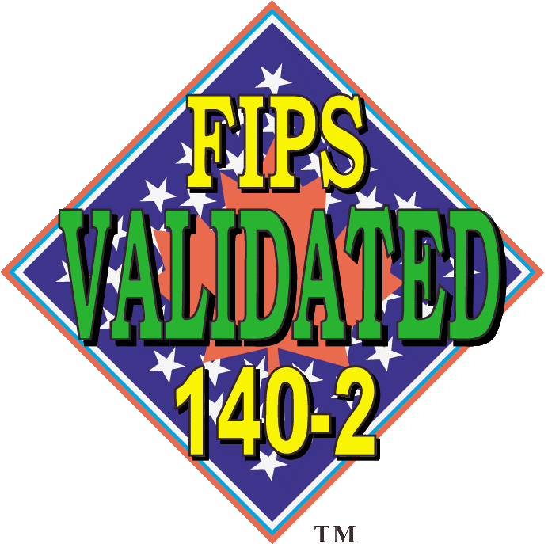














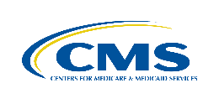









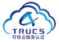











The most trusted and compliant cloud
Infrastructure for all workloads
GLOBAL
Infrastructure for all workloads
ISO 27001
ISO 27018
ISO 27017
ISO 22301
SOC 1
Type 2
SOC 2
Type 2
SOC 3
CSA STAR
Self-Assessment
CSA STAR
Certification
CSA STAR
Attestation
Hybrid
US GOV
Moderate
JAB P-ATO
High
JAB P-ATO
DoD DISA
SRG Level 2
DoD DISA
SRG Level 4
SP 800-171
FIPS 140-2
Section 508 VPAT
ITAR
CJIS
IRS 1075
Secure & well managed
INDUSTRY
PCI DSS
Level 1
CDSA
MPAA
FACT
UK
Shared
Assessments
FISC
Japan
HIPAA / HITECH Act
HITRUST
GxP
21 CFR Part 11
MARS-E
IG Toolkit
UK
FERPA
GLBA
FFIEC
REGIONAL
Cost effective
Argentina PDPA
EU
Model Clauses
UK
G-Cloud
China
DJCP
China
GB 18030
China
TRUCS
Singapore
MTCS
Australia
IRAP/CCSL
New Zealand
GCIO
Japan My Number Act
ENISA
IAF
Japan CS Mark Gold
Spain
ENS
Spain
DPA
India
MeitY
Canada
Privacy Laws
Privacy
Shield
Germany IT
Grundschutz
workbook
Notes:
More compliance coverage than AWS and Google – We have 71 certs today
GDPR gives individuals greater control over their personal data and imposes many new obligations on organizations that collect, handle, or analyze personal data.
Microsoft is committed to meeting GDPR compliance across our cloud services when enforcement begins May 25, 2018
Microsoft Azure provides industry-leading security measures and privacy policies to safeguard your data in the cloud, allowing customers to meet your GDPR obligations, using services like Azure Security Center and Azure Key Vault

Slide 18
A full set of built-in, intelligent services
Infrastructure for all workloads
MIGRATE
Infrastructure for all workloads
Hybrid
GOVERN
SECURE
Identity and Access Management
Policy Based Management
Cost Management
Security Management
Threat Protection
Microsoft Azure
Secure & well managed
CONFIGURE
PROTECT
Configuration
Update Management
Automation
Scripting
Backup
Disaster Recovery
Cost effective
MONITOR
App, Infra, and Network Monitoring
Log Analytics & Diagnostics
Notes:
Azure has a full set of built-in services to meet all your security and management needs
I understand there is a lot more you need to manage and secure in your IT environment, both in the cloud and on-premises. Your job is complex and challenging.
We have a whole set of tools natively in Azure to help you manage the full lifecycle of security and management.
We covered Security capabilities protecting your data – besides Azure Backup we also discussed how Azure Site Recovery helps in disaster recovery.
In Monitoring, we are bringing all the monitoring capabilities together in Azure Monitor, including Application Insights, Log Analytics, Network Watcher, and other monitoring tools.
We also have tools for configuration, patching, automation, and PowerShell scripting.
We have new exciting tools in the Governance area. Azure Policy, in limited preview, helps you centrally manage your policies. Azure Cost Management, previously known as Cloudyn, helps organizations manage and optimize cloud spend across a multi-cloud environment.
Plus, they’re all built in to our platform so you don’t have to worry about 3rd party integration. The services are intelligent – gathering rich intelligence about your cloud infrastructure and resources with advanced analytics and machine learning algorithms, and are hybrid—extending security and management capabilities from cloud to your on-premises environment.
In this presentation, I will walk you through three services that will get you started easily to Secure & manage your Azure resources.

Slide 19
Take simple steps to start securing and managing Azure VMs
Infrastructure for all workloads
Hybrid
Secure & well managed
Secure
your resources
Protect
your data
Monitor
app health
Cost effective
Azure Security Center
Azure Backup
Azure Log Analytics
Notes:
Take simple steps to start securing and managing Azure VMs
I just showed you the full security and management service portfolio Azure has. You may ask “how do I get started?”.
There are three simple steps you can start with to ensure your Azure cloud is Secure & well-managed:
1) Secure your Azure resources such as virtual machines, workloads, and apps with Azure Security Center.
With Azure Security Center you can gain full visibility and control of your cloud security state with a single, unified view:
Collect security data from multiple sources: Collect, search, and analyze security data from a variety of sources, including connected partner solutions like network firewalls and other Microsoft services.
Integration with existing security workflows: Access, integrate, and analyze security information using REST APIs to connect existing tools and processes.
Easily onboard cloud resources: Keep pace with rapidly changing cloud workloads. Automatically discover and onboard new resources created in your Azure subscriptions.
Continuous security assessment: monitor the security of virtual machines, networks, and Azure services using hundreds of built-in security assessments or create your own.
Built-in dashboards provide instant insights into security issues that require attention.
Centralized policy management: Ensure compliance with company or regulatory security requirements by centrally managing security policies across all your cloud workloads.
Compliance reporting: Use security data and insights to demonstrate compliance and easily generate evidence for auditors.
(If asked whether Azure Security Center supports hybrid workloads, the answer is yes: manage security across all your hybrid cloud workloads – on-premises, Azure, and other cloud platforms – in one console.)
You can also identify and mitigate risks proactively to reduce your exposure to security threats:
Proactive security assessment: Identify software and configurations that are vulnerable to attack.
Actionable recommendations: Remediate security vulnerabilities before they can be exploited by attackers with prioritized, actionable security recommendations and built-in automation playbooks.
Adaptive application controls: Block malware and other unwanted applications by applying whitelisting recommendations adapted to your specific workloads and powered by machine learning.
Controlled network access: Reduce the network attack surface with just-in-time, controlled access to management ports on Azure VMs, drastically reducing exposure to brute force and other network attacks.
Azure Security Center has robust capabilities to prevent attacks. When threats do happen, Security Center can quickly detect and respond to threats with advanced analytics and Microsoft Intelligent Security Graph.
Industry’s most extensive threat intelligence: Tap into the Microsoft Intelligent Security Graph, which uses trillions of signals from Microsoft services and systems around the globe to identify new and evolving threats.
Advanced threat detection: Use built-in behavioral analytics and machine learning to identify attacks and zero-day exploits. Monitor networks, machines, and cloud services for known attack patterns and post-breach activity.
Prioritized alerts and incidents: Focus on the most critical threats first with prioritized security alerts and incidents that map alerts of different types into a single attack campaign. Create your own custom security alerts as well.
Streamlined investigation: Quickly assess the scope and impact of an attack with a visual, interactive experience. Use predefined or ad hoc queries for deeper exploration of security data.
Contextual threat intelligence: Visualize the source of attacks on an interactive world map. Use built-in threat intelligence reports to gain valuable insight into the techniques and objectives of known malicious actors.
2) Protect your data in Azure with Azure Backup
Protect against ransomware and human errors
Protecting against ransomware is top of mind for every chief security officer and security professional. Cybersecurity Ventures predicts global ransomware damage costs will exceed $5 billion in 2017 and will continue to grow. That’s a 15X increase from 2015.
In addition to malware and malicious attacks, data also gets corrupted or lost due to human errors, such as coding an application incorrectly or inadvertently striking the wrong computer key. Studies show about 30% or more of data corruption or loss is caused due to human errors, right behind the data loss caused by malicious attacks.
The good news is that Azure Backup helps you protect against ransomware and human errors. Some features to highlight:
Enable just-in-time access for authorized users based on multifactor authentication to prevent unauthorized use.
Monitor backup activities so you can detect anomalies and issues.
Retain deleted backup data for up to 14 days so you can easily recover data corrupted due to human errors.
Store your backup data in any Azure region around the globe to meet your risk mitigation strategy while keeping your data close to your branch offices for fast recovery.
Meet compliance goals with data retention and encryption
Azure has the most comprehensive compliance portfolio available.
Enjoy up to 99 years of retention for your backup data.
Your backup data is encrypted in transit and at rest.
Start backup in minutes and restore data quickly when needed
Choose Backup from the VM blade and set up your backup in minutes with three simple steps.
Only pay for what you use, and restore data with no additional costs.
Quickly restore your data to minimize business interruption with 99.9% service availability.
Restore individual files or folders or the entire VM based on your business needs.
3) Continuously monitor your cloud health with Azure Log Analytics.
Collect and store your data from any source
Easily collect, store, and analyze your systems and operational data from any source, both on-premises and in the cloud.
Collect data from a wide range of sources including virtual machines, storage accounts, activity logs, Windows, Linux Servers, Java, .NET, legacy and modern apps.
Centrally store activity logs, network logs, infrastructure metrics, app data points, diagnostics logs and alerts.
Gain deep operational insights
Understand CPU disk and memory utilization for your virtual machines.
Get a comprehensive view of applications and network dependencies across multiple virtual machines to perform root-cause analysis more quickly.
Track configuration changes, system updates, and malware status to improve security & compliance.
Visualize data in intuitive and customizable dashboards.
Find the information you need quickly using interactive queries and full-text search.
Detect, diagnose and fix issues quickly
Get notifications and alerts with rich diagnostic information so you can always stay on top of the issues.
Separate the signal from the noise and accelerate root-cause analysis across platforms using advanced analytics including machine learning algorithms.
Automate the implementation of recommended fixes so you can address issues quickly.
Integrate with customer service systems such as your ticketing tool to speed up implementation of fixes.

Slide 20
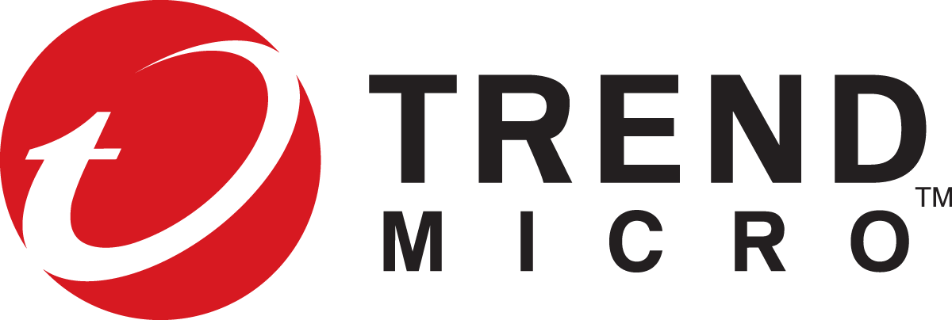







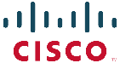
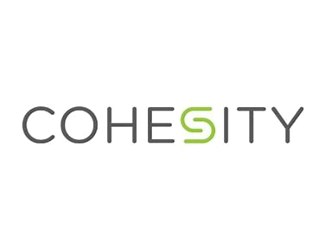



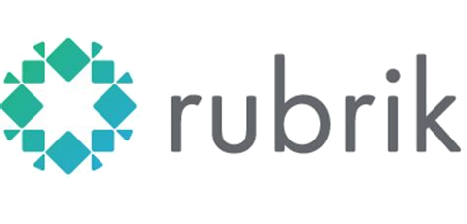

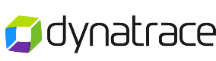

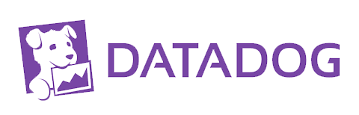

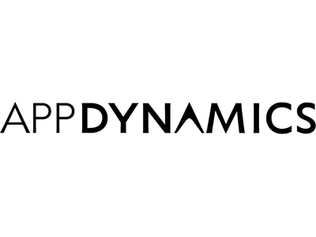

Embracing partner solutions
Infrastructure for all workloads
SECURITY
Infrastructure for all workloads
Endpoint protection:
Web application firewall:
Next-generation firewall:
Vulnerability assessment:
Hybrid
BACK UP
Secure & well managed
MONITORING
Application performance management (APM):
Infrastructure monitoring:
Network monitoring:
Cost effective
Notes:
As we have already discussed Azure has built-in security & management technologies. These tools help improve your productivity through deep product integration into Azure and built-in intelligence. These tools are modern software as a service applications so you don’t need to worry about the additional expense and operational issues typically associated with virtual machines and they are always up-to-date. Finally these tools support hybrid which enables you to get a single view across Azure and your datacenter.
We recognize that many customers have made choices for their security & management vendors on-premises and may want to continue with these vendors on Azure. It is super important that your Azure workloads are secure & well managed and you can choose to use your existing solutions as Azure has an open ecosystem.
In the case of security – Azure security center deeply integrates with a common set of partners that protect end point protection, web application or next generation firewalls or even vulnerability assessments. You can use Azure security center to monitor and in some cases provision these products.
In the case of backup you may choose to use Azure backup or one of a number of third party partners such as Commvault, Veritas and Veeam. We have seen many customers choose the built-in Azure backup to backup their Azure virtual machines on Azure while at the same time choosing to continue with their on-premises backup vendor while moving those workloads into the cloud.
In the case of monitoring you can choose to use the built-in Azure technologies that span application, network and infrastructure or a wide range of partners solutions or any of your existing vendors through integration with Azure monitor.
For the remainder of today’s session I’m going to focus on the built-in tools.

Slide 21


Coats is moving all of its datacenter assets into Microsoft Azure to gain elasticity, vastly improve performance, and lower costs.
The technology team supports anywhere, any device productivity by securing applications and data with the Microsoft Enterprise Mobility + Security suite.
“We get consistent levels of infrastructure security with Azure, because we can leverage a wealth of security technologies that Microsoft is constantly improving. We also have fewer endpoints to manage. We use Azure Security Center to monitor our environment, and with it we can be much more responsive when threats are identified.”
Harold Groothedde
Technology Solutions Director at Coats
Notes:
https://customers.microsoft.com/en-us/story/coats
https://aka.ms/kw6oep

Slide 22
Cost savings of using IaaS
Infrastructure for all workloads
Infrastructure for all workloads
Reduced data center costs
73%
Hybrid
Reduced IT outsourcing costs
33-83%
Process re-engineering improvements
85%
Secure & well managed
Profit from new enterprise sales
48-63%
Cost effective
Profit from new and larger customer sales
20-27%
Source: Forrester, The Total Economic Impact Of Microsoft Azure IaaS, June 2017
Notes:
Indeed the real cost savings come if you are able to migrate totally from an in-house IT system to one wholly supported by Azure IaaS
Forrester Consulting found potential costs saved over 5 years to be $24.6 million
Reduced overhead costs are the majority of savings, followed by reduced outsourced contracts
Cost reduction is not the only way Azure helps customers save money on IaaS.
Customers find that there are also savings inherent to the value that cloud resources provide. For example, if you spend twice as much to run a workload in the cloud, but you get three times the value (for example, due to fast time-to-results or the ability to run simulations at a finer resolution due to adding greater capacity), that’s a net win.
Customers often find value in the additional capacity or flexibility the cloud can offer: adding more compute without having to plan datacenter space or trying out new hardware by renting instead of making a large capital investment.
Many organizations have very specialized systems in-house (InfiniBand interconnects, high RAM, parallel file systems, etc) that are optimized to deliver maximum performance for key workloads. But, the clusters also end up being used for other workloads that don’t need — or can’t use — the specialized hardware.
Leveraging cloud to move the workloads that don’t need the specialized hardware into the cloud so that more jobs can be run on the optimized hardware makes the total environment deliver greater value.
One customer cut a manufacturing simulation from months to hours by moving from a small internal cluster to an 8,000 core cloud cluster. The datacenter would have to be expanded in order to add compute capacity in-house. By moving these workloads to the cloud, they were able to quickly get the additional compute capacity that made the business improvements possible.
In these and many other cases, in-house resources might have been cheaper per unit of compute, but using cloud resources delivered greater value as the speed and ease of adding extra capacity delivered the benefits of scale to the business more rapidly. When you’re considering the costs of using public cloud for big compute, remember to consider the benefits, too.

Slide 23
Customers enjoy significant ROI on Azure
Infrastructure for all workloads
466%
Infrastructure for all workloads
PaaS
Hybrid
435%
Return on Investment (ROI)
IaaS
Secure & well managed
Cost effective
On premises
Sources:
The Total Economic Impact Of Microsoft Azure IaaS, June 2017
The Total Economic Impact of Microsoft Azure Platform-as-a-Service, June 2016

Slide 24
Azure offers many ways to save money
Infrastructure for all workloads
Infrastructure for all workloads
Price match commitment
Match AWS pricing on infra
Cost and governance
Azure Cost Management
Azure Advisor
Hybrid
Secure & well managed
Innovative products and services
Low priority VMs
Per-second billing
Archival Storage
Compelling offers
Reserved VM Instances
Azure Hybrid Benefit
Cost effective
Notes:
With Azure, there are many ways that we’re working hard to save customers money.
This starts with our Price Match Commitment
Take price of the equation on commodity services, relative to AWS
If there is a comparable service, we’ll have the same price.
Innovative Products and Services
Low priority VMs
B-Series – a new burstable core VM size we’re disclosing soon
Archival Storage and other low-cost solutions
Cost and Governance
Cloudyn capabilities to help customers better understand and manage their spend.
Azure Advisor – helps customers optimize their resources for better performance, security, and costs
Compelling Offers
Azure Hybrid Benefit – provides the lowest cost for WS in the cloud
License Mobility – bring SQL server to the cloud
Visual Studio Subscription Azure Benefits
And to be announced soon, an updated Free Tier/Account to provide a broad range of services at no cost
In addition, to help you save more on VMs … RI

Slide 25
Save up to 82% with the Azure Hybrid Benefit for Windows Server + Azure Reserved VM Instances (RI)
Save 67% vs AWS for Microsoft workloads
Infrastructure for all workloads
Infrastructure for all workloads
Cost
Pay as you go
Azure Hybrid Benefit
Azure RI
Azure RI + Azure Hybrid Benefit
AWS RIs
Hybrid
Up to
40%
savings over on-premises
$$$
Up to
72%
3-year discount vs. PAYG
Secure & well managed
Up to
82%
3-year discount vs. PAYG + Azure Hybrid Benefit
$$
Up to
67%
vs AWS
Cost effective
$
*Based on comparing 3-year Azure D8_v3 RI prices with Azure Hybrid Benefit in US West 2 to AWS m4.2xlarge 3-year Standard RIs in US West (Oregon). Actual savings may vary based on region, instance type, usage or software license costs. RI may not be available in all licensing programs.
Notes:
You can save up to 82 percent on the on-demand price of running Windows Server apps in Virtual Machines when you combine the Azure Hybrid Benefit with the upcoming Reserved VM Instance offering.

Slide 26

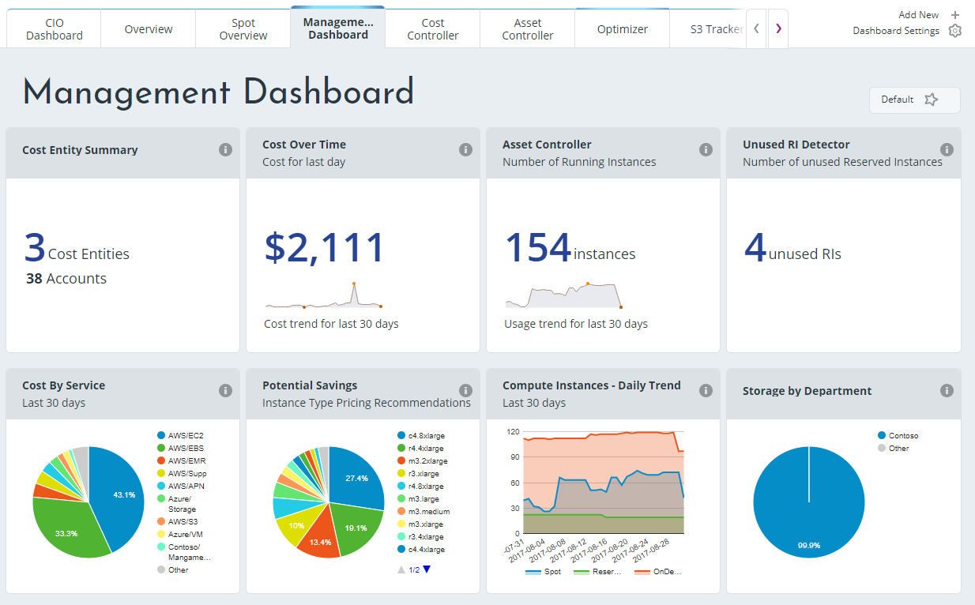
Azure Cost Management: a multi-cloud cost management and optimization solution
Infrastructure for all workloads
Monitor cloud spend
Hybrid
Drive organizational accountability
Secure & well managed
Optimize cloud efficiency
Cost effective
Notes:
With Azure Cost Management, Azure is the only cloud platform vendor that offers an end-to-end cloud cost management and optimization solution supporting a multi-cloud environment (Azure, AWS, GCP).
With Azure Cost Management, customers can:
Monitor cloud spend
Visualize data in consolidated and custom views
Track usage and cost trends
Detect spend anomalies and usage inefficiencies
Forecast future spend based on historical data
Drive organizational accountability
Allocate usage and costs using resource tags
Produce chargeback and showback reports
Let teams access data and insights with Role-Based Access Control
Alert stakeholders automatically for spend anomalies and overspending risks
Optimize cloud efficiency
Increase resource utilization with virtual machine right-sizing
Eliminate idle resources
Improve Reserved Instance management

Slide 27





Malaysia Airlines reduced total annual costs by about 45% by migrating to Azure.
“By paying only for what we use and expanding and contracting those resources to meet business needs, we manage SAP much more effectively on Azure than we ever did in our own datacenter.”
Tan Kok Meng, Chief Information Officer
Malaysia Airlines
Notes:
https://customers.microsoft.com/en-us/story/malaysia-airlines-berhad
https://aka.ms/a0zp7e

Slide 28
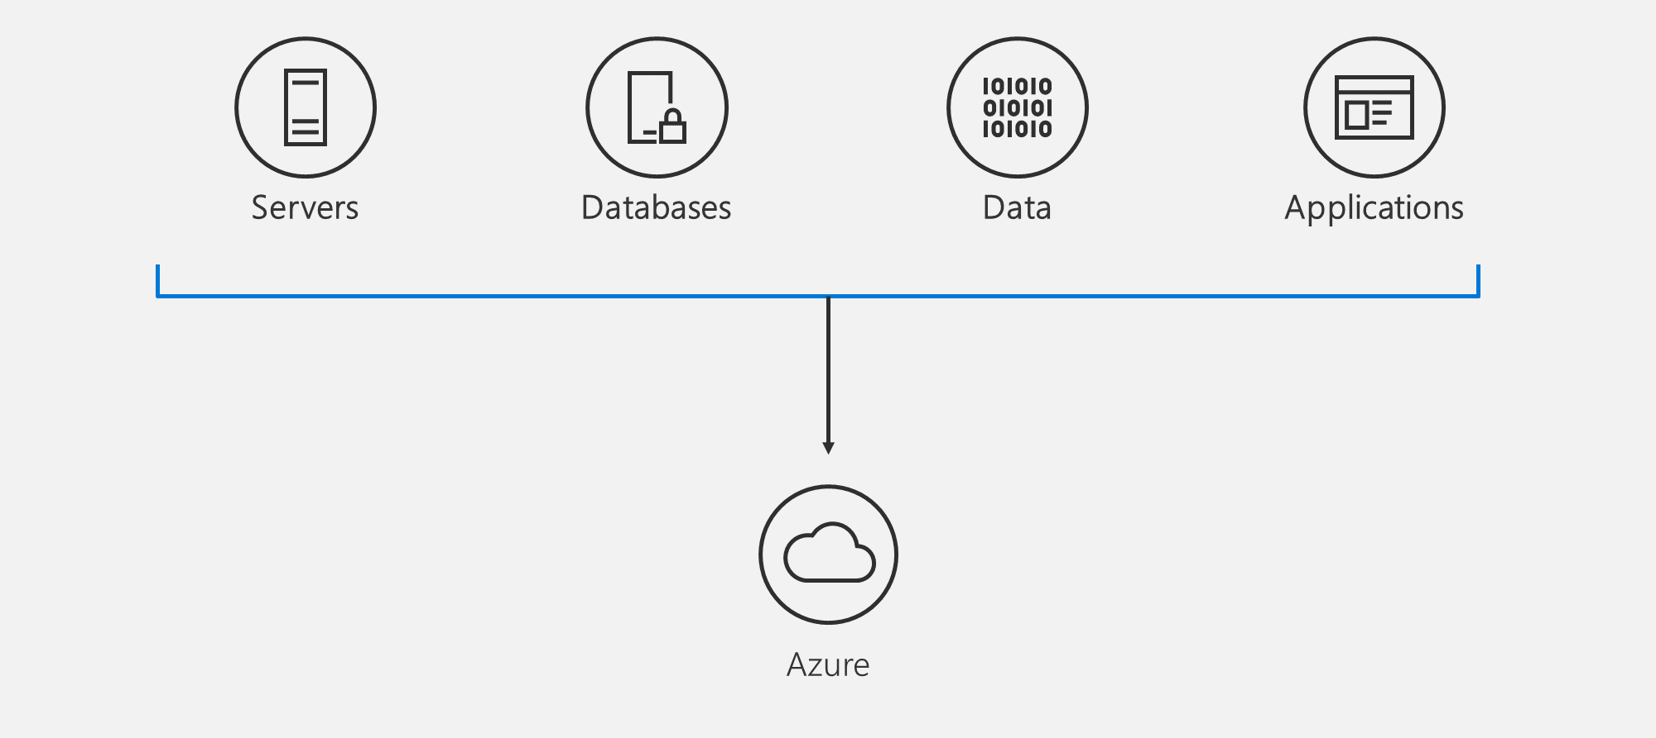
What are customers looking to migrate?
Notes:
Servers—[Windows Server, Linux – physical or virtual]
Lift and shift legacy apps (e.g., web servers) and infrastructure (e.g., AD, DNS) to Azure IaaS
Refactor corporate apps/workloads to O365 (e.g., SharePoint, Exchange, Lync/SfB)
Modernize critical workloads to latest OS in Azure
Databases—[SQL Server]
Lift & shift SQL Server apps to Azure SQL Database Managed Instance (MI); consider SQL IaaS for 3rd party integration needs
Lift and shift SQL DW/BI workloads to Azure SQL Database MI or Azure SQL DW
Modernize critical SQL apps to Azure SQL Database
Data—[Archive, Blob, File servers]
Replicate over the network (E.g., Azure Copy, Azure Archive Storage)
Refactor file servers to Azure Files
Transfer offline based on data volume (e.g., using Azure Data Box, Azure Import/Export
Applications—[internal LOB apps, customer facing apps - .NET/LAMP]
Re-host legacy apps on Azure IaaS
Refactor critical app components (e.g., Azure container service, DevOps)
Rearchitect key apps (e.g., Azure App Service, Azure Functions)

Slide 29
Azure migration journey
Top-down buy in: Business case | Executive sponsorship | Business and IT alignment
Migrate*
Rehost
(lift and shift)
Refactor
Assess
Optimize
Rearchitect
Rebuild
Foundational investments: Technical | Process | People
*These migration strategies are adopted from Gartner research. Gartner also calls out a 5th strategy called “Replace” which is about SaaS. We won’t focus on that here..
Notes:
Replace – consider for completeness. [Azure Migrate discovers for O365?]
Let’s talk about the various paths along your migration journey.
It all starts with discovering your on-prem applications, data, and infrastructure, assessing them for migration readiness and determine the mix of tactics that you will use during the move – ranging from simple lift and shift to various levels of modernization during migration (i.e., refactor, rearchitect, rebuild). And then once in Azure, how do you keep your workloads optimized continuously (e.g., security, monitoring, backups, opex spends).
Note: In some cases you might just retire the workload or replace it with a SaaS solution – we won’t cover those aspects in detail here

Slide 30
Azure Migrate (now generally available)
Easily discover VMware VMs and applications, including rich service dependency maps
Insightful workload assessments:
Right-sized Azure resources based on utilization history
Estimated monthly run costs in Azure
Migration risks and recommended tools
Hyper-V and physical environment assessment coming soon
Azure
Windows Server
Linux
Get started at no cost today: https://aka.ms/azuremigrate
Notes:
Timing precision?
Hit ISV assessment tools upfront in the deck. Using both in combination.

Slide 31
Modern infrastructure foundations to begin your cloud journey
Infrastructure for all workloads
Hybrid
Secure & well managed
Cost effective

Slide 32
Secure, cost-effective and powerful
Compute
Networking
Storage
Security and Management
Notes:
Built within an ecosystem of more than 300,000 partners, Azure offers hundreds of services to enable your cloud needs, including compute, storage, networking, and security & management.
But, unlike our competitors, we don’t just set you up with a cloud infrastructure and call the project complete … we have an innovative network of partners and experts that offer ongoing cloud training, services, and support to help you get up-to-speed, optimize your infrastructure, and continue to make smart choices about where, when, how, or if to evolve your infrastructure.

Slide 33
Compute
Azure compute provides online processing time and hosting environments for running applications in the cloud via virtual machines.
Virtual Machines
Virtual Machine Scale Sets
Availability Sets
Disks
Notes:
Azure IaaS is designed for high-end workloads and will automatically scale up or down to 1000 instances
Azure has all the power & flexibility of a Virtual Machine:
Minimal learning curve for existing virtualization pros
Run most Windows or Linux-based workloads
Easiest target for migrating to the cloud
Flexible instance sizes—use the best fit for your workload
Advanced networking and storage capabilities
Per second billing with pay-as-you-go billing (or RI)
For existing virtualization pros, the learning curve is minimal as Azure runs on most Windows or Linux-based workloads
Virtual Machines offer advanced networking & storage capabilities
Virtual Machine Scale Sets:
All of the power and flexibility of a Virtual Machine
Designed for high-end workloads
Automatically scale up (or down) to 1000 instances
Availability Sets:
Disks: Persistent, secured disk storage for Azure Virtual Machines
Simple scaling on demand lets you create thousands of disks simultaneously in minutes
Industry-leading durability and availability simultaneously replicates your data to three different replicas.
Offers you more security with granular access control
Lets you easily migrate in minutes
Multiple storage options available

Slide 34
Compute

Slide 35

Compute options for all types of apps
Entry level
Burstable
General Purpose
Compute Intensive
Storage Optimized
A
Av2
B
D
Dv2
Dv3
F
Fv2
L
High Performance Computing
Memory Optimized
Graphics Intensive
Purpose-built SAP HANA
G
Ev3
M
NC
NCv2
NV
ND
H
HANA
NCv3
NVv2
NDv2
(coming soon)
(coming soon)
Notes:
Key Messages: This slide simply sets the stage. Azure compute offers a rich development environment and IaaS capabilities that can help you develop a broad range of applications. For each type of application you can select the right VM that best suits your needs. We continue to expand and enrich the variety of VMs available to you so you can continue to fuel your innovation and growth to Azure.
Products recently introduced include:
1. M-Series VMs now certified for SAP HANA. You can now develop applications on Azure for the SAP HANA platform that has been recently certified for M-Series. The M-series family of Azure virtual machines are the largest memory-optimized VMs to date. These VMs are ideal for heavy in-memory workloads such as SAP HANA. With the M-Series, these databases can load large datasets into memory and utilize the fast memory access with huge amounts of vCPU parallel processing to speed up queries and enable real-time analytics. You can deploy these large workloads in minutes and on-demand, scaling elastically as your usage demands. Refer to the blog for the announcement https://azure.microsoft.com/en-us/blog/azure-m-series-vms-are-now-sap-hana-certified/
2. NVIDIA’s latest GPU for HPC and AI is available in Azure. For those of you focused on HPC applications and AI, not too long ago we announced major expansion of our GPU fleet. NVIDIA GPUs are at the heart of a lot of discovery and innovation. And with our tools like Batch, Batch AI, and the Data Science Virtual Machine images, Azure customers and developers are in a great position to expand what is possible and bring to market innovative AI and HPC applications.https://azure.microsoft.com/en-us/blog/ncv3-vms-generally-available-other-gpus-expanding-regions/ NCv3 brings NVIDIA’s latest GPU – the Tesla V100 – to our best-in-class HPC, machine learning, and AI products to bring huge amounts of value across a variety of industries. One preview customer told us their speech recognition models trained in less than 20 minutes, instead of the 1-2 hours that previous generation GPUs required. Another customer told us about the 40-50% performance boost they saw on their reservoir simulations. The ND-series, powered by NVIDIA Tesla P40 GPUs based on the new Pascal Architecture, will be excellent for training and inference. These instances will provide more than twice the performance over the previous generation for AI workloads utilizing CNTK, TensorFlow, Caffe, and other frameworks. The ND-series also offer a much larger GPU memory size (24 gigabytes), enabling you to fit much larger neural net models. Also, like our NC-series, the ND-series will offer RDMA and InfiniBand connectivity, so you will be able to run large-scale training jobs spanning hundreds of GPUs.
3. We have also announced two new VM sizes, E64i_v3 and E64is_v3, which are isolated to hardware and dedicated to a single customer. These VMs are best suited for workloads that require a high degree of isolation from other customers for compliance and regulatory requirements. You can also choose to further subdivide the resources by using Azure’s support for nested VMs. The E64i_v3 and E64is_v3 will have the exact same performance and price as their cousins E64_v3 and E64s_v3 and will be available in each of the regions where E64_v3 and E64s_v3 are available today. The small letter ‘i’ in the VM name denotes that they are “Isolated” sizes. Unlike the E64_v3 and E64s_v3, the two new E64i_v3 and E64is_v3 sizes are hardware bound sizes. They will live and operate on our Intel® Xeon® Processor E5-2673 v4 2.3GHz hardware only and will be available until at least December 2021. We will provide reminders 12 months in advance of the official decommissioning of the sizes and offer an updated isolated size like these sizes on our next hardware version. These two new E64i_v3 and E64is_v3 sizes will be available in the on-demand portal. Starting on May 1st, 2018, they will also be made available for purchase as 1-year Reserved VM Instances.
The E64i_v3 and E64is_v3 are joining our other Isolated VM sizes in the Azure family:
Standard_D15_v2
Standard_DS15_v2
Standard_E64i_v3
Standard_E64is_v3
Standard_F72s
Standard_G5
Standard_GS5
Standard_L32s
Standard_M128ms
Standard_M128s
We encourage you to use these VMs for workloads needing a high degree of isolation.
----------------------------------------
BACKGROUND INFO
Entry Level
A-series VMs have CPU performance and memory configurations best suited for entry-level workloads like development and test. They are economical and provide a low-cost option to get started with Azure.
Example use cases include development and test servers, low-traffic web servers, small-to-medium databases, servers for proof-of-concepts, and code repositories.
Burstable
B-series are economical virtual machines that provide a low-cost option for workloads that typically run at a low-to-moderate baseline CPU utilization, but sometimes need to burst to significantly higher CPU utilization when the demand rises.
Example use cases include development and test servers, low-traffic web servers, small databases, micro services, servers for proof-of-concepts, and build servers.
General Purpose
The Dv3 and Ev3 sizes are able to run Windows 2016 hosts and enable Nested Virtualization and Hyper-V Containers for these new VM sizes. Nested virtualization allows you to run a Hyper-V server on an Azure virtual machine. With nested virtualization, you can run a Hyper-V Container in a virtualized container host, set up a Hyper-V lab in a virtualized environment, or to test multi-machine scenarios. You can find more information on Nested Virtualization on Azure.
Our new Dv3 VM sizes are a good balance of memory to vCPU performance, with up to 64 vCPUs and 256 GiB of RAM. Our newly named Ev3 sizes provide you with more memory to vCPU than the Dv3, so you can run larger workloads on sizes up to our largest E64 size, with 64 vCPUs and 432 GiB of RAM. D2v3 instances are the latest hyper-threaded generation of general purpose instances.
Compute Intensive
The F-series VM sizes sport a higher CPU-to-memory ratio. They feature 2 GB RAM and 16 GB of local Solid State Drive (SSD) per CPU core, and are optimized for compute-intensive workloads. The F-series is based on the 2.4 GHz Intel Xeon E5-2673 v3 (Haswell) processor, which can achieve clock speeds as high as 3.1 GHz with the Intel Turbo Boost Technology 2.0. Example use cases include scenarios like batch processing, web servers, analytics, and gaming.
Azure now offers the fastest Intel Xeon Scalable processor, code-named Skylake, in the public cloud. In Azure, we have seen growing demand for massive large-scale computation by customers doing financial modeling, scientific analysis, genomics, geothermal visualization, and deep learning. Our drive to continuously innovate in Azure allows us to offer cost-effective and best-in-class hardware for these world-changing workloads.
Memory Optimized
The M-series family of Azure virtual machines are the largest memory optimized VMs to date. These VMs are ideal for heavy in-memory workloads, such as SAP HANA. With the M-series, these databases can load large datasets into memory and utilize the fast memory access with huge amounts of vCPU parallel processing to speed up queries and enable real-time analytics. You can deploy these large workloads in minutes and on-demand, scaling elastically as your usage demands.
G-series VMs feature the latest Intel Xeon processor E5 v3 family, two times more memory, and four times more Solid State Drive storage (SSDs) than the General Purpose D-series. G-series sport RAM of up to ½ TB and 32 CPU cores, and provide unparalleled computational performance, memory, and local SSD storage for your most demanding applications. Example use cases include large SQL and NoSQL databases, ERP, SAP, and data warehousing solutions.
Optimized for in-memory hyper-threaded applications, the E-series family of Azure virtual machines are optimized for heavy in-memory applications such as SAP HANA. These VMs are set up with high memory-to-core ratios that make them well-suited for relational database servers, with medium-to-large caches, and in-memory analytics. The E-series VMs range from 2 to 64 vCPUs and 16 to 432 GiB RAM, respectively.
Two new VM sizes, E64i_v3 and E64is_v3, which are isolated to hardware and dedicated to a single customer. These VMs are best suited for workloads that require a high degree of isolation from other customers for compliance and regulatory requirements. The E64i_v3 and E64is_v3 will have the exact same performance and price as their cousins E64_v3 and E64s_v3, and they will be available in each of the regions where E64_v3 and E64s_v3 are available today. The small letter “I” in the VM name denotes that they are “Isolated” sizes.
Graphics Intensive
NCv3 is available in East and South Central regions in the US. NCv3 brings NVIDIA’s latest GPU – the Tesla V100 – to our best-in-class HPC, machine learning, and AI products to bring huge amounts of value across a variety of industries. One preview customer told us their speech recognition models trained in less than 20 minutes, instead of the 1-2 hours that previous generation GPUs required. Another customer told us about the 40-50% performance boost they saw on their reservoir simulations.
The ND-series, powered by NVIDIA Tesla P40 GPUs based on the new Pascal Architecture, will be excellent for training and inference. These instances will provide more than twice the performance over the previous generation for FP32 (single-precision floating-point operations), for AI workloads utilizing CNTK, TensorFlow, Caffe, and other frameworks. The ND-series also offer a much larger GPU memory size (24 gigabytes), enabling you to fit much larger neural net models. Also, like our NC-series, the ND-series will offer RDMA and InfiniBand connectivity, so you will be able to run large-scale training jobs spanning hundreds of GPUs. They are available in East and West US and Southeast Asia.
HPC
H-series VM sizes are suitable for any compute-intensive workload like complex engineering and scientific workloads like computational fluid dynamics, crash simulations, seismic exploration, and weather forecasting simulations. H-series VMs come with the fastest CPUs in public cloud, as well as RDMA with InfiniBand, which allows you to run high-performance computing (HPC) apps. The H-series is available across multiple regions in the US, Europe, and Asia.
Azure offers a comprehensive set of compute options for all types of apps, including entry-level, general purpose, memory optimized, storage optimized, and compute intensive.
Our HPC and GPU fleet has fast performance with built-in Infiband support. Let’s take a look at some of the new compute types we’ve added:
H-series: InfiniBand networking (industry-leading)
SAP Large Instances up to to 20 TB (industry-leading)
Fast networking (FPGA) – up to 30 gb/s from 25 gb/s last year (industry-leading)

Slide 36
.. From entry-level to storage optimized …
Intel Haswell E5-2673 v3
Lowest cost, flexible CPUs
Up to 8vCPUs, 32GiB RAM
Intel® Xeon® Platinum 8168 processor (Skylake)
Entry level
Burstable
General Purpose
Compute Intensive
Storage Optimized
A
Av2
B
D
Dv2
Dv3
F
Fv2
L
Intel Broadwell E5-2673 v4
Hyper-Threaded CPUs
Up to 64 vCPU’s, 256GB RAM
Notes:
Entry Level
A-series VMs have CPU performance and memory configurations best suited for entry-level workloads like development and test. They are economical and provide a low-cost option to get started with Azure.
Example use cases include development and test servers, low-traffic web servers, small-to-medium databases, servers for proof-of-concepts, and code repositories.
Burstable
B-series are economical virtual machines that provide a low-cost option for workloads that typically run at a low-to-moderate baseline CPU utilization, but sometimes need to burst to significantly higher CPU utilization when the demand rises.
Example use cases include development and test servers, low-traffic web servers, small databases, micro services, servers for proof-of-concepts, and build servers.
General Purpose
The Dv3 and Ev3 sizes are able to run Windows 2016 hosts and enable Nested Virtualization and Hyper-V Containers for these new VM sizes. Nested virtualization allows you to run a Hyper-V server on an Azure virtual machine. With nested virtualization, you can run a Hyper-V Container in a virtualized container host, set up a Hyper-V lab in a virtualized environment, or to test multi-machine scenarios. You can find more information on Nested Virtualization on Azure.
Our new Dv3 VM sizes are a good balance of memory to vCPU performance, with up to 64 vCPUs and 256 GiB of RAM. Our newly named Ev3 sizes provide you with more memory to vCPU than the Dv3, so you can run larger workloads on sizes up to our largest E64 size, with 64 vCPUs and 432 GiB of RAM. D2v3 instances are the latest hyper-threaded generation of general purpose instances.
Compute Intensive
The F-series VM sizes sport a higher CPU-to-memory ratio. They feature 2 GB RAM and 16 GB of local Solid State Drive (SSD) per CPU core, and are optimized for compute-intensive workloads. The F-series is based on the 2.4 GHz Intel Xeon E5-2673 v3 (Haswell) processor, which can achieve clock speeds as high as 3.1 GHz with the Intel Turbo Boost Technology 2.0. Example use cases include scenarios like batch processing, web servers, analytics, and gaming.
Azure now offers the fastest Intel Xeon Scalable processor, code-named Skylake, in the public cloud. In Azure, we have seen growing demand for massive large-scale computation by customers doing financial modeling, scientific analysis, genomics, geothermal visualization, and deep learning. Our drive to continuously innovate in Azure allows us to offer cost-effective and best-in-class hardware for these world-changing workloads.
B-series:
Web servers, small DBs, and dev/test
Dv3
Hyper-Threaded CPUs unlock full potential of latest processors
First wave for Nested virtualization and Hyper-V containers
Fv2:
For HPC scenarios: Scientific modeling, cluster computing, gaming and analytics

Slide 37
.. From memory optimized to HPC
Nvidia P100 GPU
InfiniBand networking
HPC scenarios
Intel Xeon E5-2673 v4 (Broadwell)
Hyper-Threaded CPUs
Up to 64 vCPUs, 432GiB RAM
Nvidia Tesla M60
High Performance Computing
Memory Optimized
Graphics Intensive
Purpose-built SAP HANA
G
Ev3
M
NC
NCv2
NV
ND
H
HANA
‘
NCv3
NVv2
NDv2
‘
(coming soon)
‘
(coming soon)
Intel Xeon E7-8890 v3 (Haswell)
Largest VMs in Azure
Up to 128 vCPUs, 4TiB RAM
Skylake Processor
Nvidia Tesla
V100
Nvidia Tesla P40
Infiniband networking
Deep learning, AI
Notes:
NVIDIA’s latest GPU for HPC and AI is available in Azure. For those of you focused on HPC applications and AI, not too long ago we announced major expansion of our GPU fleet. NVIDIA GPUs are at the heart of a lot of discovery and innovation. And with our tools like Batch, Batch AI, and the Data Science Virtual Machine images, Azure customers and developers are in a great position to expand what is possible and bring to market innovative AI and HPC applications.https://azure.microsoft.com/en-us/blog/ncv3-vms-generally-available-other-gpus-expanding-regions/ NCv3 brings NVIDIA’s latest GPU – the Tesla V100 – to our best-in-class HPC, machine learning, and AI products to bring huge amounts of value across a variety of industries. One preview customer told us their speech recognition models trained in less than 20 minutes, instead of the 1-2 hours that previous generation GPUs required. Another customer told us about the 40-50% performance boost they saw on their reservoir simulations. The ND-series, powered by NVIDIA Tesla P40 GPUs based on the new Pascal Architecture, will be excellent for training and inference. These instances will provide more than twice the performance over the previous generation for AI workloads utilizing CNTK, TensorFlow, Caffe, and other frameworks. The ND-series also offer a much larger GPU memory size (24 gigabytes), enabling you to fit much larger neural net models. Also, like our NC-series, the ND-series will offer RDMA and InfiniBand connectivity, so you will be able to run large-scale training jobs spanning hundreds of GPUs.
M-Series VMs now certified for SAP HANA. You can now develop applications on Azure for the SAP HANA platform that has been recently certified for M-Series. The M-series family of Azure virtual machines are the largest memory-optimized VMs to date. These VMs are ideal for heavy in-memory workloads such as SAP HANA. With the M-Series, these databases can load large datasets into memory and utilize the fast memory access with huge amounts of vCPU parallel processing to speed up queries and enable real-time analytics. You can deploy these large workloads in minutes and on-demand, scaling elastically as your usage demands. Refer to the blog for the announcement https://azure.microsoft.com/en-us/blog/azure-m-series-vms-are-now-sap-hana-certified/
Memory Optimized
The M-series family of Azure virtual machines are the largest memory optimized VMs to date. These VMs are ideal for heavy in-memory workloads, such as SAP HANA. With the M-series, these databases can load large datasets into memory and utilize the fast memory access with huge amounts of vCPU parallel processing to speed up queries and enable real-time analytics. You can deploy these large workloads in minutes and on-demand, scaling elastically as your usage demands.
G-series VMs feature the latest Intel Xeon processor E5 v3 family, two times more memory, and four times more Solid State Drive storage (SSDs) than the General Purpose D-series. G-series sport RAM of up to ½ TB and 32 CPU cores, and provide unparalleled computational performance, memory, and local SSD storage for your most demanding applications. Example use cases include large SQL and NoSQL databases, ERP, SAP, and data warehousing solutions.
Optimized for in-memory hyper-threaded applications, the E-series family of Azure virtual machines are optimized for heavy in-memory applications such as SAP HANA. These VMs are set up with high memory-to-core ratios that make them well-suited for relational database servers, with medium-to-large caches, and in-memory analytics. The E-series VMs range from 2 to 64 vCPUs and 16 to 432 GiB RAM, respectively.
Two new VM sizes, E64i_v3 and E64is_v3, which are isolated to hardware and dedicated to a single customer. These VMs are best suited for workloads that require a high degree of isolation from other customers for compliance and regulatory requirements. The E64i_v3 and E64is_v3 will have the exact same performance and price as their cousins E64_v3 and E64s_v3, and they will be available in each of the regions where E64_v3 and E64s_v3 are available today. The small letter “I” in the VM name denotes that they are “Isolated” sizes.

Slide 38

New VM-Series for Confidential Computing
A new VM-series backed by specialized hardware, which will include the latest generation of INTEL SGX.
Based on Trusted Execution Environments: Intel SGX, Virtualization Based Security (VBS)
Comm application patterns: Protect data confidentiality, integrity and sensitive IP
Protect data and code in use: Isolated portion of processor and memory, code and data cannot be viewed/modified
Cloud offering: TEE-enabled compute platform, Cloud attestation, First-party‒enabled services
Centrally combine data sources, Communicate with secure endpoints, licensing and DRM
Top data breach threats mitigated
Data fully in customer control
Code protected and verified by customer
Cloud platform outside of trusted compute base
Limited Preview
May ‘18
Notes:
https://azure.microsoft.com/en-us/blog/azure-confidential-computing/
This is a limited preview access under NDA (announced via blog) of a specialized Virtual Machine Series (DC-series) that will become part of the Azure Compute portfolio and the first installment of the broader Azure Confidential Computing (ACC) initiative. Put simply, confidential computing offers a protection that to date has been missing from public clouds: encryption of data while in use.
This new VM-Series is based on the latest generation of Intel SGX (Mehlow) hardware that will become available in our Azure datacenters. It brings a Trusted Execution Environment (TEE) enabled computing platform to Azure.
BACKGROUND: Confidential computing ensures that when data is “in the clear,” which is required for efficient processing, the data is protected inside a Trusted Execution Environment (TEE - also known as an enclave), an example of which is shown in the figure below. TEEs ensure there is no way to view data or the operations inside from the outside, even with a debugger. They even ensure that only authorized code is permitted to access data. If the code is altered or tampered, the operations are denied and the environment disabled. The TEE enforces these protections throughout the execution of code within it.

Slide 39
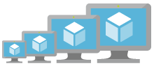

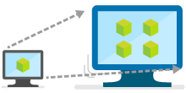
New VM Scale Sets enhancements
With VM Scale Sets, you can confidently deploy thousands of identical Virtual Machines in minutes and focus on what matters—your application.
Provides auto scale-out and scale-in based on health checks
Enables easy integration with Azure SLB or App Gateway
Auto-OS image update for guest images
Deploy low-priority VMs and realize cost savings
Support for cross-zone deployment
Public Preview
April ‘18
Notes:
We have recently introduced a number of enhancements to our Azure VMSS. As you may already know, with VM Scale Sets, you can confidently deploy hundreds of identical virtual machines in minutes. With easy updates at scale, focus more on what matters—your application—and less on the infrastructure. Virtual Machine Scale Sets are elastic and designed to support your scale-out applications —including stateless web front ends, container orchestration, and microservices clusters. Azure Container Service and Azure Service Fabric run on Virtual Machine Scale Sets.
We continue to add capabilities to increase the value we provide to our development community making it easier for you to develop applications on Azure. For example, now VMSS support Auto-OS image update https://azure.microsoft.com/en-us/updates/auto-os-upgrades/ for guest images, you do not have to worry about the scaling capabilities of your apps once they are in production, with recent capabilities announced in March you have support for cross-zone deployment to improve your SLAs.
Virtual Machine Scale Sets integrate with Azure networking resources such as Azure Load Balancer and Application Gateway. Easily spread your workloads across the virtual machines in your Virtual Machine Scale Set, and configure network address translation (NAT) rules to connect to specific virtual machine instances for troubleshooting.
Autoscale allows you to have the right amount of resources running to handle the load on your application. It allows you to add resources to handle increases in load and also save money by removing resources that are sitting idle. You specify a minimum and maximum number of instances to run and add or remove VMs automatically based on a set of rules. Having a minimum makes sure your application is always running even under no load. Having a maximum limits your total possible hourly cost. You automatically scale between these two extremes using rules you create.
Last but not least your users can now take advantage of support for low-priority VMs as they run the VMSS applications that you have developed.

Slide 40
Storage
Azure provides a unified distributed storage system offering durability, encryption at rest, strongly consistent replication, and auto load-balancing
Notes:
Azure IaaS is designed for high-end workloads and will automatically scale up or down to 1000 instances
Azure has all the power & flexibility of a Virtual Machine:
Minimal learning curve for existing virtualization pros
Run most Windows or Linux-based workloads
Easiest target for migrating to the cloud
Flexible instance sizes—use the best fit for your workload
Advanced networking and storage capabilities
Per second billing with pay-as-you-go billing (or RI)
For existing virtualization pros, the learning curve is minimal as Azure runs on most Windows or Linux-based workloads
Virtual Machines offer advanced networking & storage capabilities
Virtual Machine Scale Sets:
All of the power and flexibility of a Virtual Machine
Designed for high-end workloads
Automatically scale up (or down) to 1000 instances
Availability Sets:
Disks: Persistent, secured disk storage for Azure Virtual Machines
Simple scaling on demand lets you create thousands of disks simultaneously in minutes
Industry-leading durability and availability simultaneously replicates your data to three different replicas.
Offers you more security with granular access control
Lets you easily migrate in minutes
Multiple storage options available

Slide 41
Secure, scalable and highly available storage options for every use case
Disk Storage
Object Storage
File storage
Premium
Standard
Azure Blobs
Azure Files
Azure NetApp Files
Reliable, persistent, high performing storage for Virtual Machines
Secure, centralized storage target for backup/disaster recovery
Lift and shift of legacy applications that require file shares to the cloud
Data Transport
Hybrid Storage
Azure Import/Export
Azure DataBox
Azure StorSimple
Azure File Sync
Avere*
Move or migrate data into Azure
Secure, intelligent data tiering between on-premises and cloud storage
Notes:
Azure IaaS is designed for high-end workloads and will automatically scale up or down to 1000 instances
Azure has all the power & flexibility of a Virtual Machine:
Minimal learning curve for existing virtualization pros
Run most Windows or Linux-based workloads
Easiest target for migrating to the cloud
Flexible instance sizes—use the best fit for your workload
Advanced networking and storage capabilities
Per second billing with pay-as-you-go billing (or RI)
For existing virtualization pros, the learning curve is minimal as Azure runs on most Windows or Linux-based workloads
Virtual Machines offer advanced networking & storage capabilities
Virtual Machine Scale Sets:
All of the power and flexibility of a Virtual Machine
Designed for high-end workloads
Automatically scale up (or down) to 1000 instances
Availability Sets:
Disks: Persistent, secured disk storage for Azure Virtual Machines
Simple scaling on demand lets you create thousands of disks simultaneously in minutes
Industry-leading durability and availability simultaneously replicates your data to three different replicas.
Offers you more security with granular access control
Lets you easily migrate in minutes
Multiple storage options available

Slide 42
Azure Disks
Performance Tiers
Simplified Management
Resource Group
Preview
Managed Disks Highly available and scalable
Premium SSD Disks Provisioned performance for Enterprise Prod
Standard SSD Disks Cost effective performance for entry-level workloads
Standard HDD Disks HDD based, cost effective for dev-test workloads
Industry leading ZERO % Annual Failure Rate
Best in class VMs with
High IOPS/BW
< 1ms latency for cached operations
Developer Support
REST API Support
Easy Migration / DR / Backup
Rich partner ecosystem
Enterprise grade durability with 3 replicas
80,000 IOPS & 2,000 MB/s
Disk throughput per VM
Blob Cache technology
Up to 160,000 IOPS
Notes:
Start with question:
- How many of you are using Azure Disks?
- How many of you are currently using Managed Disks?
How many of you are using Premium Disks?
What about Managed Premium Disks?
We have Disks offers based on the performance tiers:
Premium Disks, those are SSD based which provide high IOPS, throughput and consistent latency
Standard Disks using Magnetic drives which does not provide provisioned performance, however, this is a cost effective option for applications who do not require very high performance. This is ideal for test and dev workloads
We have recently introduced as a public Preview on June 4th - Azure Standard SSD Disks, a low-cost SSD offering, are optimized for test and entry-level production workloads requiring consistent latency. Standard SSD Disks can also be used for big data workloads that require high throughput. Standard SSDs deliver lower latency compared to Standard HDDs, while improving reliability and scalability for your applications, and are available with all Azure VM sizes.
Standard SSDs can be easily upgraded to Premium SSDs for more demanding and latency-sensitive enterprise workloads. Offered as a managed disk solution, Standard SSDs come with the same industry leading durability and availability that you expect from Azure Disks.
Lets look at Management options:
We recently launched Managed Disks which provide better manageability and support high availability deployment options. We have deep dive session on this topic so I am not going to spend too much time here.
We also have unmanaged disks, those are legacy disks. One of the unique capability is that we have REST support. You do not need to mount the disks to your VM to access the disks.

Slide 43
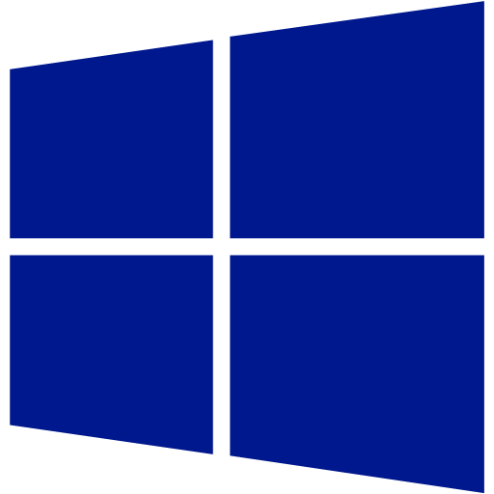



Azure Files
Lift and Shift
Variety of clients/protocols
SMB 2.1, 3.0, REST
Windows, Linux, Mac OS
Azure and on premises access
Secure
Encryption at rest
Secure communication over SMB
Virtual Machine
Application
Client
Azure Files \\<account>.file.windows.net\<share>
SMB:
Port 445 outbound
On Premises
Azure
Notes:
Primary focus is lift and shirt for all scenarios that currently utilize File shares on premises
Differentiators
Variety of protocols/ clients
Encryption at rest – first cloud to offer this for fully managed file services
Sync

Slide 44
Object storage for every use case
Azure Blob
Hot
Cool
Archive
Frequently accessed data
Less frequently accessed data
Rarely accessed data
PER TB PER MONTH
$18.40
$10.00
$2.00
PER 10K WRITE OPERATIONS
$0.05
$0.10
$0.10
RETRIEVAL TIMES
Immediate
Immediate
Hours
Cloud native application data storage
Repository for server backups
Medical records archiving
USE CASES
Notes:
Azure Object Storage provides secure, scalable, high-performing solutions for a broad spectrum of use cases
Azure object storage handles massive amounts of data; over 130 trillion objects to date
And it processes over 30 million transactions per second
Object storage is also designed to help protect customer data with encryption at rest as the default
We’ve recently brought Archive storage into public preview.
Archive is designed to handle data that is rarely accessed
and offers industry competitive pricing of only 18 cents per TB per month making the cloud an ideal place to handle your backup needs

Slide 45
Scalability & performance roadmap
 | Standard HDD Managed Disks | Standard SSD Managed Disks | Premium SSD Managed Disks
Disk Latency | Double digit millisecond | Single digit millisecond | Uncached Read: ~4ms Uncached Write: ~2ms -> ~1ms (Q3 CY2018)
Max Disk Size | 4TB -> 32TB (H2 CY18) | 4TB -> 32TB (H2 CY18) | 4TB -> 32TB (H2 CY18)
Max Disk IOPS | 500 IOPS | 500 IOPS | 7,500 IOPS
Max Disk Bandwidth | 60 MBps | 60 MBps | 250 MBps
* The disk performance target is subject to change.
Notes:
Apart from the new features, larger, faster and more performant disks are what the customer will always look for.

Slide 46
Networking

Slide 47
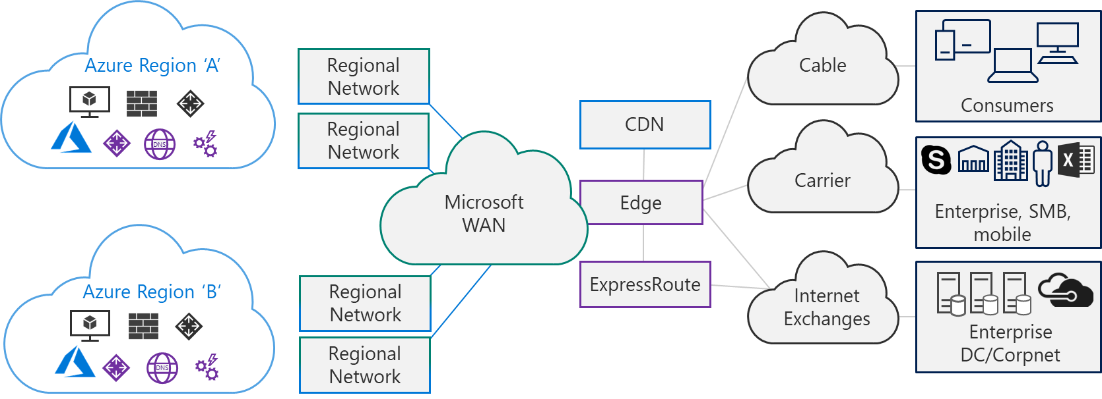
Azure Networking
DC Hardware | Services | Intra-Region | WAN Backbone | Edge and ExpressRoute | CDN | Last Mile
SmartNIC/ FPGA SONiC | Virtual Networks Load Balancing VPN Services Firewall DDoS Protection DNS & Traffic Management | DC Networks Regional Networks Optical Modules | Software WAN Subsea Cables Terrestrial Fiber National Clouds | Internet Peering ExpressRoute | Acceleration for applications and content | E2E monitoring (Network Watcher, Network Performance Monitoring)

Slide 48
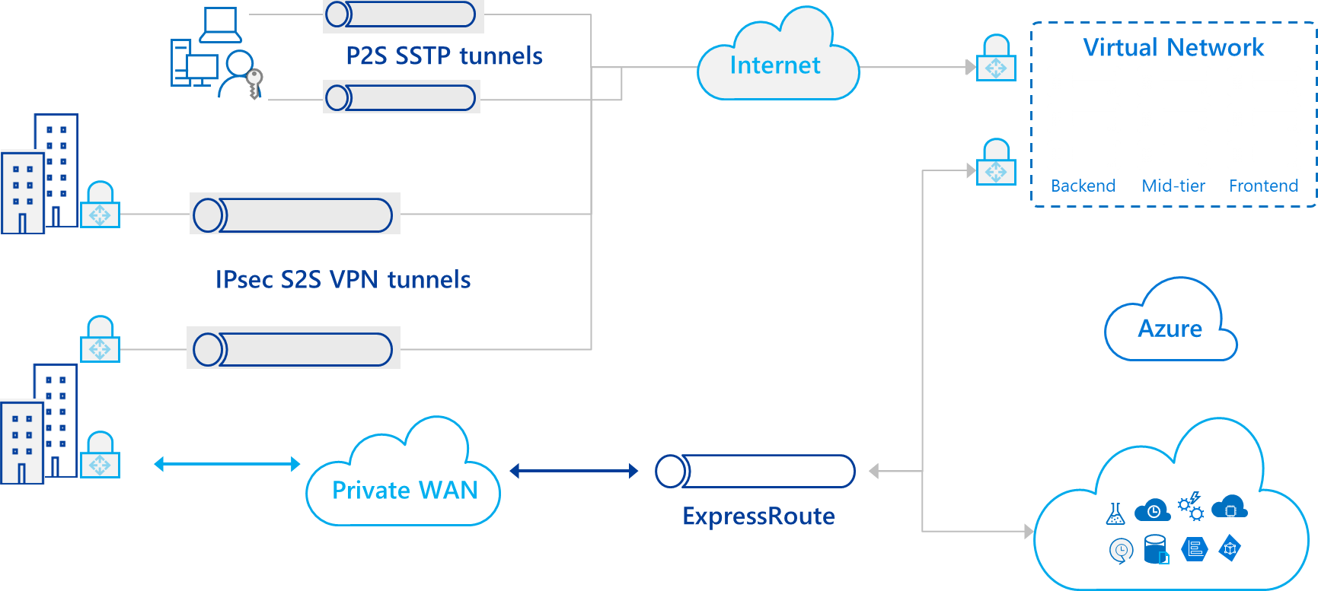
Hybrid Connectivity Overview

Slide 49
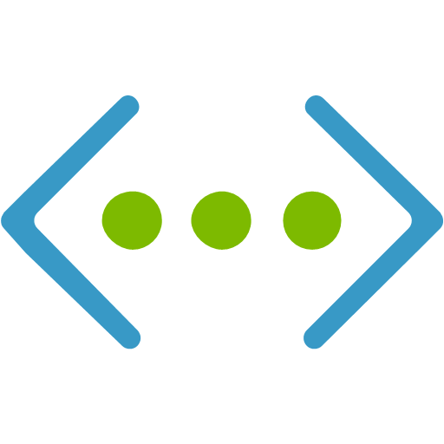
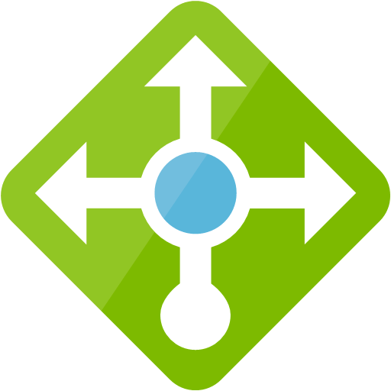




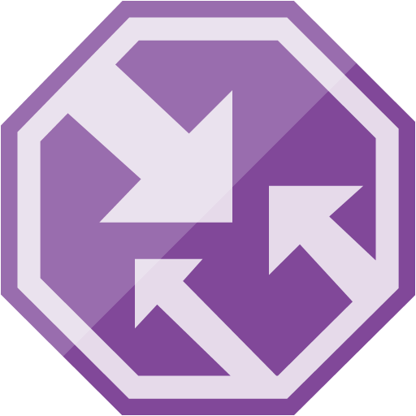
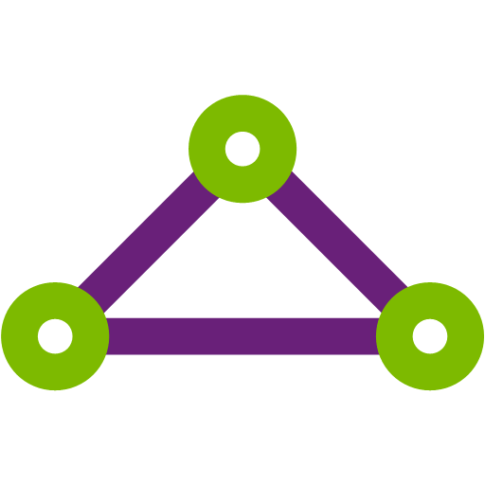

Robust networking infrastructure services
Virtual Network
Provision private networks, optionally connect to on premise datacenters. NSG, User Defined Routes, & IP addresses.
Load Balancer
Deliver high availability and network performance to your applications
Application Gateway/WAF
Build scalable and highly-available web front ends in Azure
DDoS Protection
Protect your Azure resources from DDoS attacks
VPN Gateway
Establish secure, cross-premise connectivity
Azure DNS
Host your DNS domain in Azure
Content Delivery Network
Ensure secure, reliable content delivery with broad global reach
Traffic Manager
Route incoming traffic for high performance and availability
ExpressRoute
Dedicated private network fiber connections to Azure
Network Watcher
Network performance monitoring and diagnostics solution
Notes:
These are all the component pieces of Azure’s networking infrastructure

Slide 50

Microsoft Global Network
Greenland
Svalbard
United States
Sweden
Norway
Russia
Canada
United Kingdom
Poland
Ukraine
Kazakistan
Russia
France
One of the largest private
networks in the world
8,000+ ISP sessions
130+ edge sites
44 ExpressRoute locations
33,000 miles of lit fiber
SDN Managed (SWAN, OLS)
United States
Turkey
Algeria
Iran
China
Pacific Ocean
Mexico
Atlanta Ocean
Libya
Egypt
Saudi Arabia
India
Myanmar (Burma)
Mali
Niger
Chad
Sudan
Pacific Ocean
Nigeria
Ethiopia
Venezuela
Colombia
Dr Congo
Peru
Angola
Indonesia
Brazil
Zambia
Indian Ocean
Bolivia
Nambia
South Africa
Australia
Owned Capacity
Data center
Argentina
Leased Capacity
Moving to Owned
Edge Site
DCs and Network sites not exhaustive

Slide 51
Security and Management
Azure Active Directory
Cloud based directory and identity management
Azure Resource Manager
Organize, deploy and control resources in Azure
Azure Security Center
Prevent, detect, and respond to threats with increased visibility
Azure Advisor
Optimize across four different areas: high availability, performance, security, and cost
Azure Log Analytics
Collect, search, and visualize machine data from on-premises and cloud
Azure Key Vault
Protect secrets such as passwords and keys securely
Azure Backup
Protect your virtual machines, data, or enterprise workloads by securely backing it up to Azure
Azure Site Recovery
Orchestrated failovers/back to Azure, Azure to Azure or data center to data center–great for migration!
Notes:
Azure offers all these tools to manage and secure your data including the Azure Security Center to prevent, detect and respond to threats, Azure Backup, and Azure Site Recovery

Slide 52
© 2017 Microsoft Corporation. All rights reserved. Microsoft, Windows, and other product names are or may be registered trademarks and/or trademarks in the U.S. and/or other countries. The information herein is for informational purposes only and represents the current view of Microsoft Corporation as of the date of this presentation. Because Microsoft must respond to changing market conditions, it should not be interpreted to be a commitment on the part of Microsoft, and Microsoft cannot guarantee the accuracy of any information provided after the date of this presentation. MICROSOFT MAKES NO WARRANTIES, EXPRESS, IMPLIED OR STATUTORY, AS TO THE INFORMATION IN THIS PRESENTATION.

